Slide 2

The DIY Artificial Pancreas
Hacking Wetware with Open Source Software and Hardware
Notes:
https://www.bing.com/images/search?view=detailV2&ccid=dgo12COR&id=05C87FA5BC14BA2724E464D54D7D3FAF747411A3&thid=OIP.dgo12CORpR_TUfpGkdDhWgHaF2&mediaurl=http%3a%2f%2fmedia.buzzle.com%2fmedia%2fimages-en%2fillustrations%2fhuman-biology%2f1200-62515514-pancreas-anatomy.jpg&exph=949&expw=1200&q=pancreas&simid=608046778217465743&selectedIndex=22&ajaxhist=0

Slide 3
Agenda
whoami?
Introduction to Diabetes
Hardware
Software and Safety
Iterative Improvements
Live Demo
Results
Exponential Growth
Questions?

Slide 4
whoami?
LAGORIO\Jay (jay@lagor.io)
B.S. Computer Science, UMBC (2008)
M. Eng. Electrical Engineering, NPS (2015)
CISSP, various SANS certifications over the years
Developer, IT Consultant, Private Investigator
Projects at UMBC as a student, many projects thereafter
Maryland-based Ambulance company
Other sectors, and myself

Slide 5
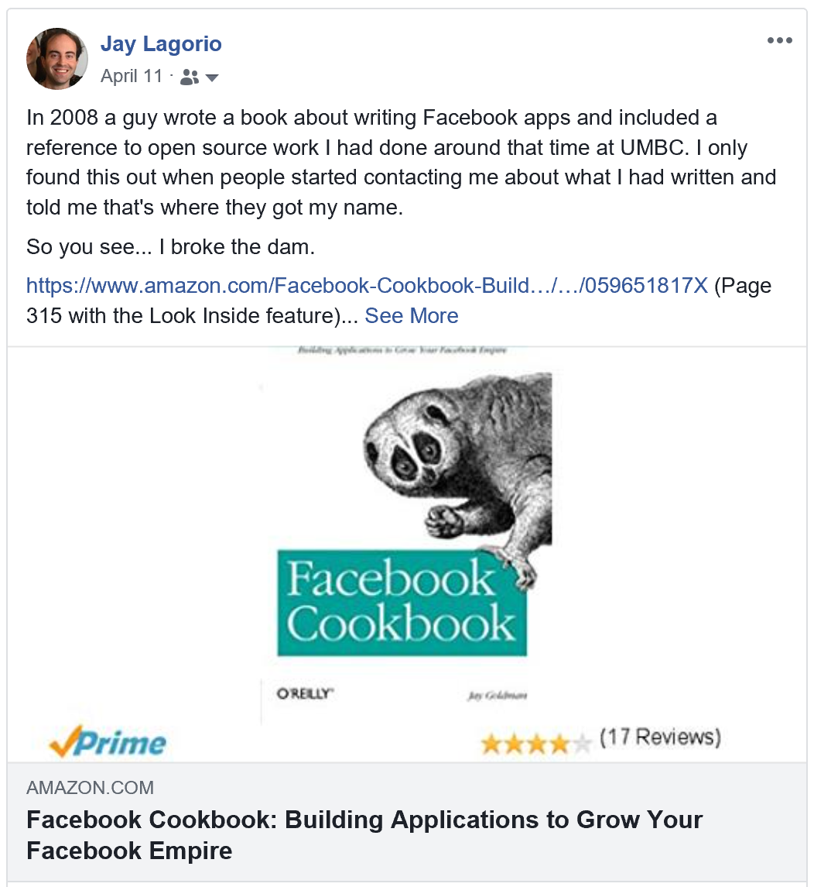

whoami?
.NET Developer
Facebook API 1.0 library
Workflow management (PHP too!)
Craal
Lots of personal projects
Notes:
They gave me a paper table to keep track of my data with, but why would I use paper? Sugar. This was before CGM was on my radar at all since that data would have been even more useful.

Slide 6
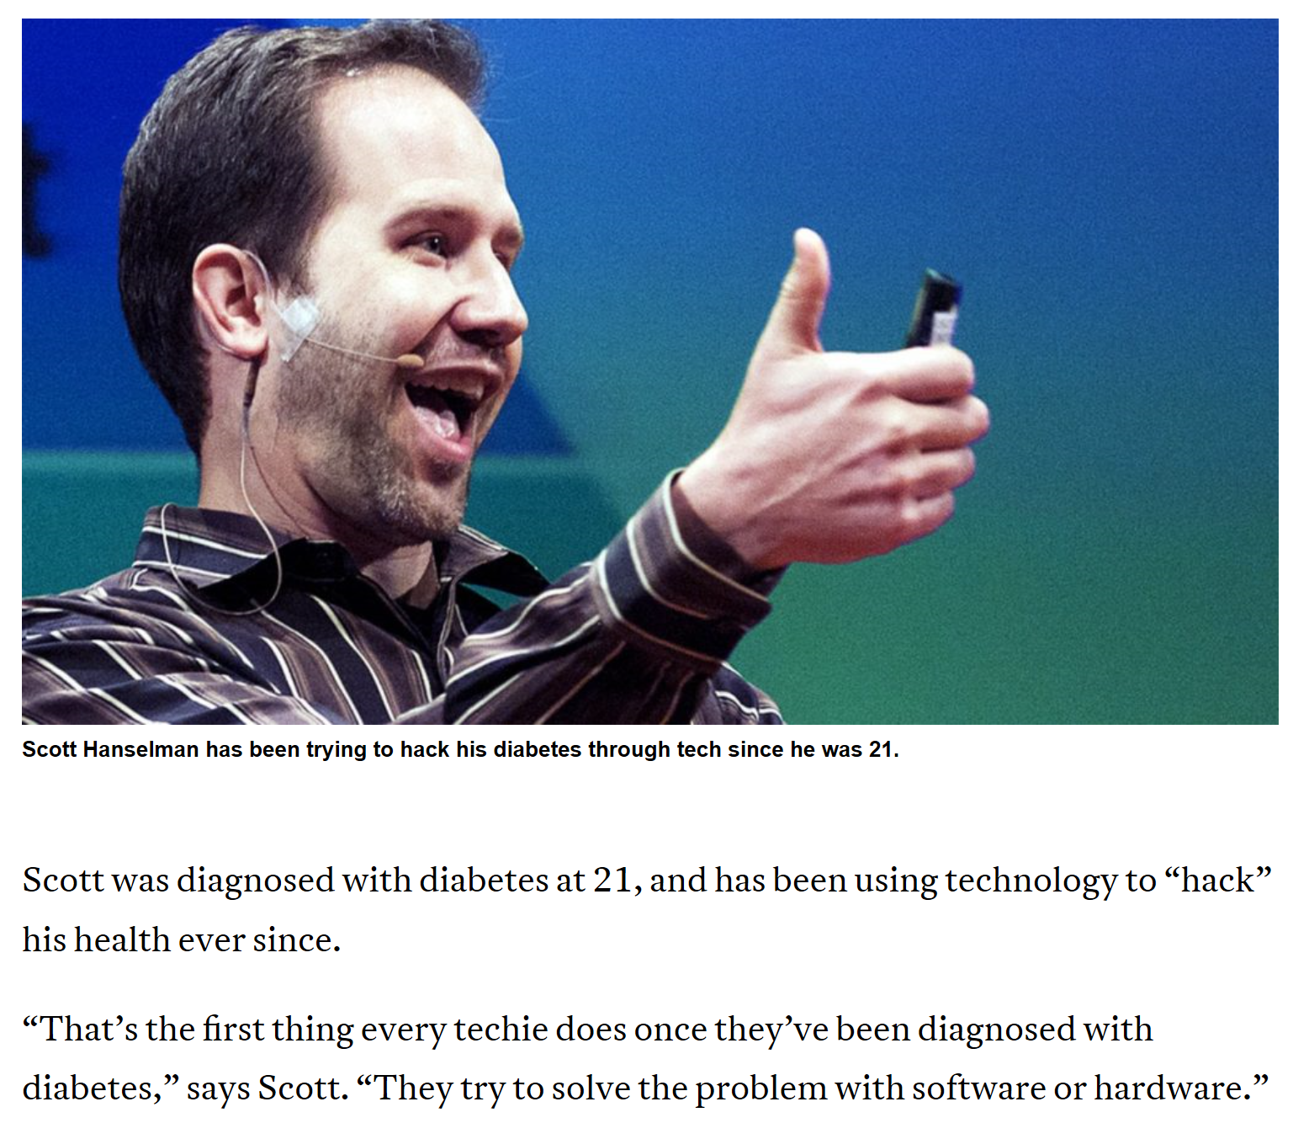
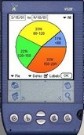

Slide 7
Agenda
whoami?
Introduction to Diabetes
Hardware
Software and Safety
Iterative Improvements
Live Demo
Results
Exponential Growth
Questions?

Slide 8
Introduction to Diabetes
Diabetes affects nearly 200 million people worldwide and comes in two flavors
A deficiency in the pancreas to properly produce insulin (Type I), genetic
A deficiency in the body to absorb insulin (Type II)
We’ve all heard the meme: There will be a cure in 5 years ™
Insulin is a hormone required to sustain human life, so people with this disease must obtain it from another source
Long acting
Short acting

Slide 9
Introduction to Diabetes
Administered according to a complex formula accounting for:
Carbohydrates
Physical activity
Sickness
Preexisting insulin levels
Adrenalin
Insulin Sensitivity
Straddle a tenuous line between their blood sugar rising too high or dropping too low.

Slide 10
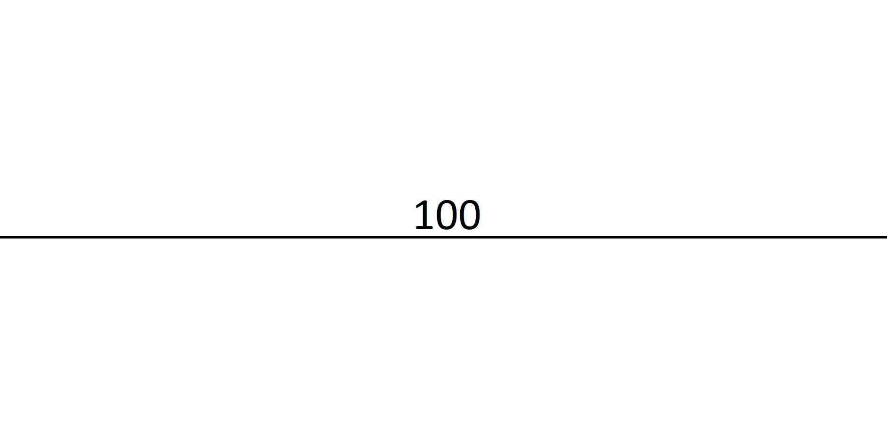
Introduction to Diabetes

Slide 11
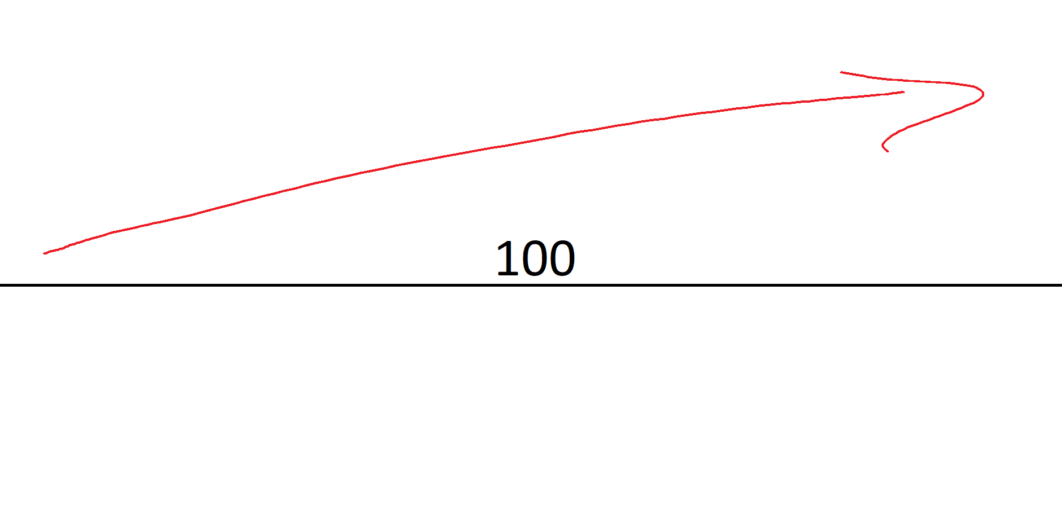
Introduction to Diabetes
Notes:
Levels that are too high or remain high for too long through carbohydrate intake take years off your life – although extreme high levels can cause stroke, seizures, organ failure, brain damage, and death over a period of hours or days.

Slide 12
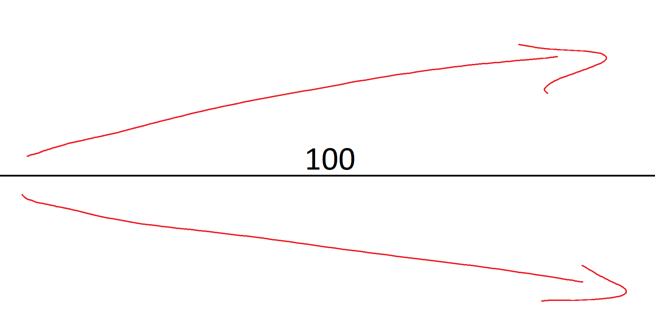
Introduction to Diabetes
Notes:
Drop too low through exercise or insulin use and, after maybe tens of minutes progressing through symptoms that include anxiety, tremors, sweating, dizziness, confusion, and heart palpitations and right after you pass out around 35, without intervention you die. This is assuming you feel it – may people are what’s called hypounaware for which some of the technology we’re going to talk about is a life requirement. It’s a difficult balance to maintain consistently, so many patients choose to allow their blood sugar to remain higher than it should be over time because in the immediate term it’s easier that way.

Slide 13
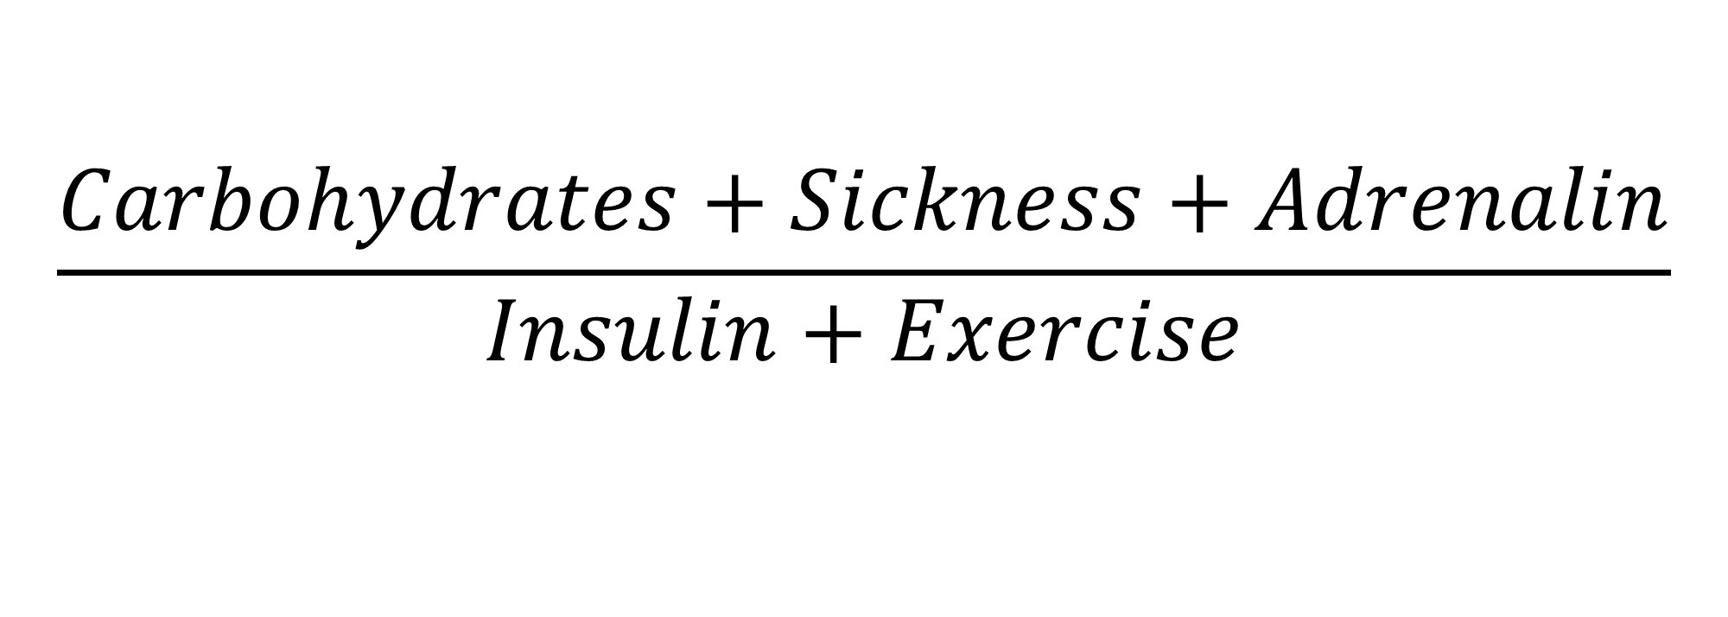
Introduction to Diabetes
$$\frac{Carbohydrates+Sickness+Adrenalin}{Insulin+Exercise}$$

Slide 14
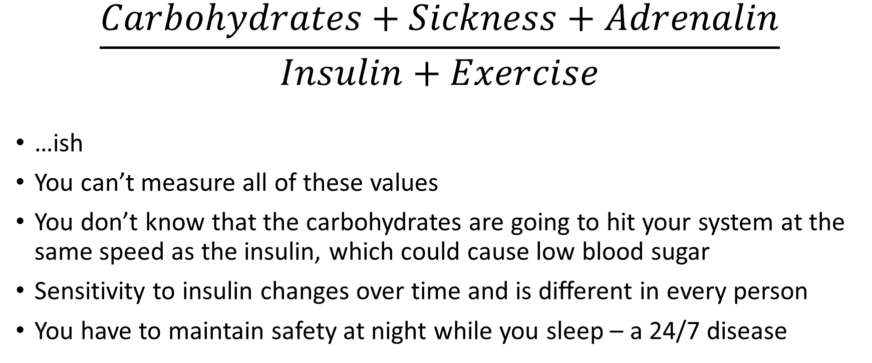



Introduction to Diabetes
$$\frac{Carbohydrates+Sickness+Adrenalin}{Insulin+Exercise}$$
…ish
You can’t measure all of these values
You don’t know that the carbohydrates are going to hit your system at the same speed as the insulin, which could cause low blood sugar
Sensitivity to insulin changes over time and is different in every person
You have to maintain safety at night while you sleep – a 24/7 disease
Notes:
This is living with it, but how do you measure how you’re doing?

Slide 15
Introduction to Diabetes
How do you measure how well you’re doing?
An A1c blood test measures a chemical related to your glucose levels over a period of about 3 months
In aggregate, it’s a good approximation of how close your average blood sugar has been over that time
Blood sugar fluctuates during the day due to eating, so you have to maintain control because it affects your A1c
Blood sugar should not fluctuate wildly during sleep, so if you do well over night you get that measurement improvement “for free” since you’re not eating while your range is maintained

Slide 16
Introduction to Diabetes
Some technology exists to make it easier to maintain some form of control over blood sugar
Largely go toward easing the burden of monitoring and managing symptoms
None of these solutions take a decision-making role in management of the disease
Injections: people used to give themselves multiple injections of different kinds of insulin per day
Use an insulin pump to both slowly dose background insulin throughout the day and to give themselves larger (but riskier!) doses required at meals
Worn for days at a time, eliminating multiple painful injections throughout the day and reducing a lot of medical waste

Slide 17
Introduction to Diabetes
Blood Glucose Measurement: Most patients still must use some finger sticks to draw blood to check their blood sugar
A point-in-time measurement lacking real-world context like trend direction
Continuous Glucose Monitor (CGM): Sensor that stays attached to you for days at a time
Takes a reading every five minutes, exposing trends
The CGM receiver alarms when readings venture outside of pre-set parameters
Wake the patient up at night to take needed action to raise or lower their blood sugar back to safe levels
Notes:
CGMs measure a chemical in the interstitial fluid under your skin and, using a very expensive to develop and test algorithm, interpret that raw sensor data into something that resembles the measurement we’re looking for. This is important for later.
But I want to leave you with some last tips on how to survive with this disease and some statistics on how well you’ll probably do.

Slide 18
Introduction to Diabetes
No bedtime snacks, you don’t know what’s going to happen while you sleep
You intentionally go to bed on the higher end of the scale, but not too high, because your glucose will be pushed down by the unthinking insulin pump and you don’t want to alarm or wake up too low
Every meal, even meals you have often that are usually predictable, can become an hours long battle to get back to normal
Rule of thumb: If you wake up too high there is no recovery to a good state during the day

Slide 19
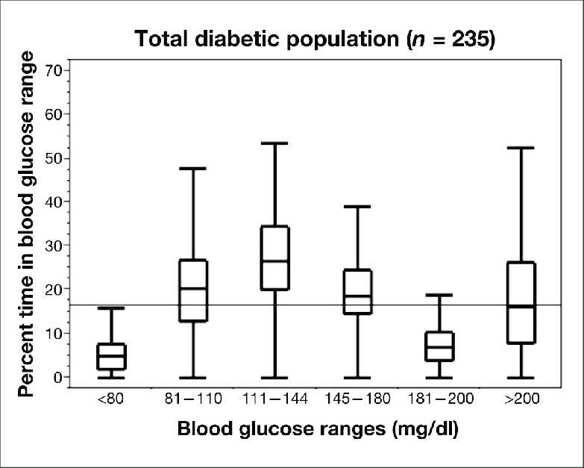
Introduction to Diabetes
Notes:
https://www.researchgate.net/figure/Percent-of-time-spent-in-blood-glucose-ranges-during-the-course-of-continuous-insulin_fig2_51460927
Effect of Diabetes Mellitus on Outcomes of Hyperglycemia in a Mixed Medical Surgical Intensive Care Unit
May 2011
In range defined as 80 – 180 average time spent in range is 65%

Slide 20
Agenda
whoami?
Introduction to Diabetes
Hardware
Software and Safety
Iterative Improvements
Live Demo
Results
Exponential Growth
Questions?

Slide 21
Hardware
It must be restated:
None of the FDA-certified components take action on behalf of the patient and a human is still required to be in the loop.

Slide 22
Hardware
We need to develop a solution that:
Takes the data from the CGM
Processes it with what it already knows about our bodies and current state
Predicts future effects based on existing state, proposed changes, and medication calculations
And delivers a command to an insulin pump to do something other than deliver regular, unchanging background insulin.

Slide 23
Hardware
This requires us to overcome four technical challenges:
We need a small, low-power and portable platform that the user can easily bring with them through their day to do all of this.
A visualization solution that allows us to monitor the system both historically and as it works in real-time is required to monitor the status of the solution.
We need to collect blood sugar readings from an FDA-certified CGM system.
We need to be able to query and control an FDA-certified insulin pump.

Slide 24
Hardware
The Raspberry Pi, particularly the Pi Zero, and Intel Edison are ultra-portable platforms that make phenomenal solutions on which to run our code
Each has built-in Bluetooth and Wi-Fi making it easy to connect them to known networks or tether them to a cell phone when not at home without needing extra attachments
We can collect CGM data over Bluetooth without having to plug the manufacturer-provided receiver into the board, although that remains an option with USB OTG

Slide 25
Hardware
Our CGM and platform problems solved, the Open Source hardware community stepped in and created two solutions to the pump problem.
The Explorer Board for the Intel Edison
Explorer HAT for the Raspberry Pi
900 MHz radios that while advertised as general-purpose ISM band radios communicate with the insulin pumps using the proprietary protocol
Protocol reverse engineered by a community member over the course of several years: @bewestisdoing

Slide 26
Hardware
This requires us to overcome four technical challenges:
We need a small, low-power and portable platform that the user can easily bring with them through their day to do all of this.
A visualization solution that allows us to monitor the system both historically and as it works in real-time is required to monitor the status of the solution.
We need to collect blood sugar readings from an FDA-certified CGM system.
We need to be able to query and control an FDA-certified insulin pump.

Slide 27
Hardware
This requires us to overcome four technical challenges:
We need a small, low-power and portable platform that the user can easily bring with them through their day to do all of this.
A visualization solution that allows us to monitor the system both historically and as it works in real-time is required to monitor the status of the solution.
We need to collect blood sugar readings from an FDA-certified CGM system.
We need to be able to query and control an FDA-certified insulin pump.
Notes:
This is rule #1 of fightclub, because we all here at a hacker con understand garbage in, garbage out

Slide 28
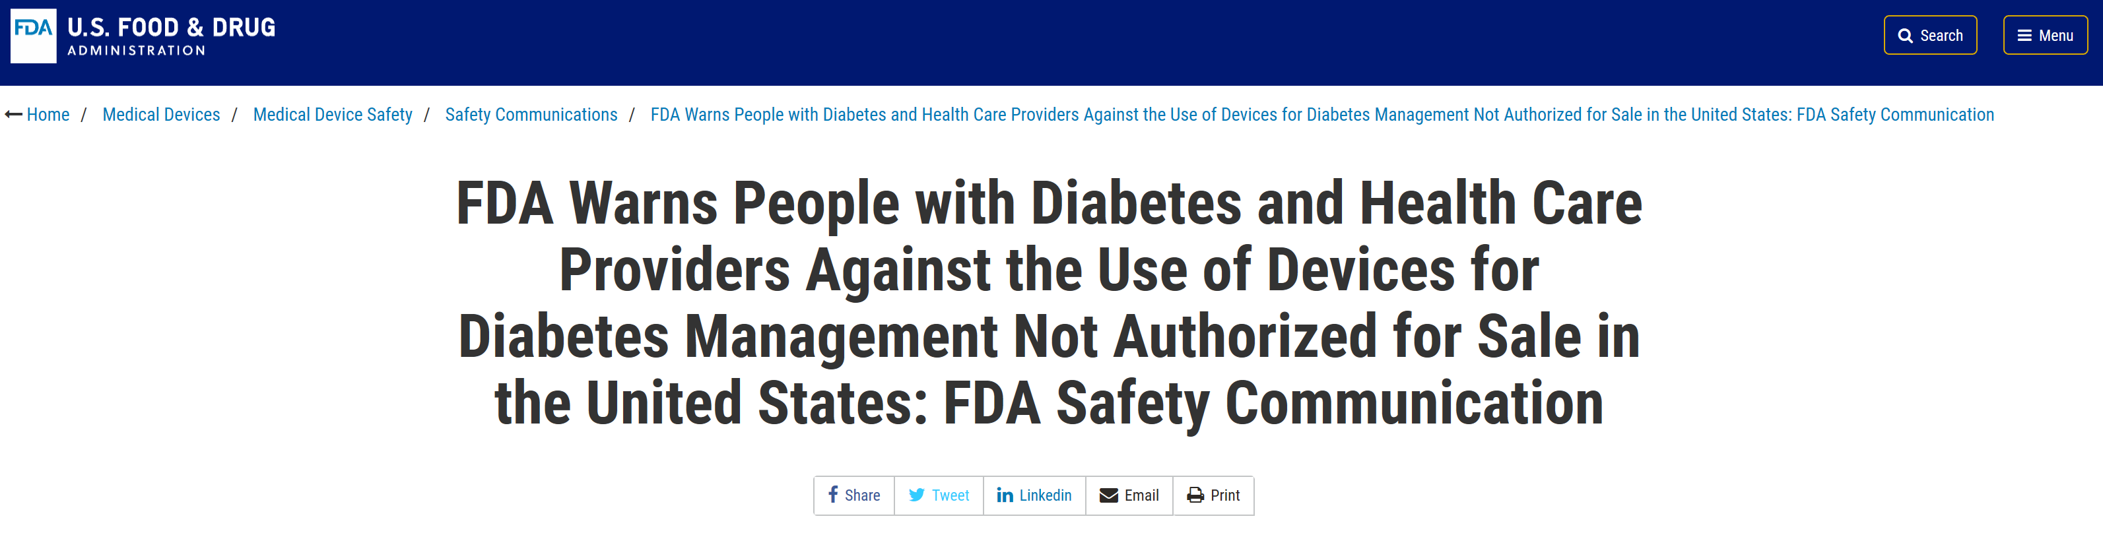
Hardware
Notes:
So when someone tries to interpret raw sensor data their own way, has their devices act on it for them based on that flawed data, and then lands themselves in the hospital it’s pretty frustrating because then the regulators go and add FUD to the discussion. There are other second order effects as well.

Slide 29
Hardware
Older insulin pumps that have wireless connectivity allowed the manufacturer to use a proprietary protocol to communicate with the pump.
Discovered and turned into a Black Hat talk in 2013 with an emphasis toward how this could be misused
Manufacturers significantly limited how this functionality could be used on newer pumps.
This wrinkle requires us to find and purchase older, used pumps and to use custom hardware and software.

Slide 30
Hardware
Medtronic stopped manufacturing pumps that were remotely controllable, but did not recall the devices
Older devices are already hard to acquire:
eBay
Craigslist
Mercari
MedWOW
Price gouging galore: started at ~$300, skyrocketed to > ~$1000
After the FDA warning about unapproved uses of medical devices, meaning CGM algorithms, another bomb drops
Notes:
No one can resist a chance to take advantage of an already disadvantaged community, as we’ll discuss later

Slide 31
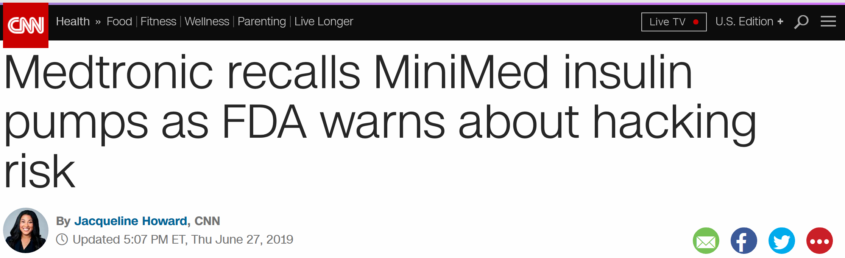
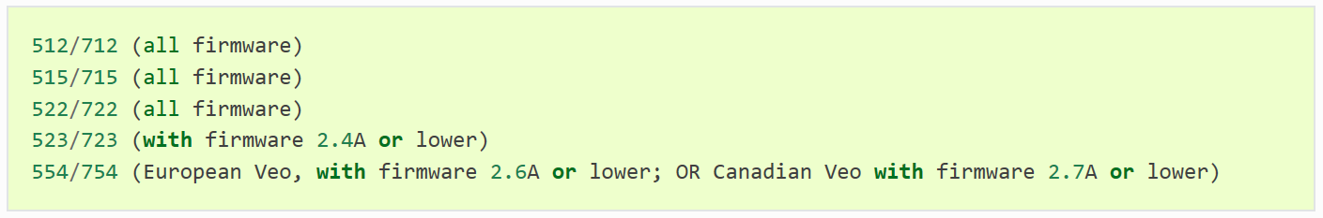
Hardware
Notes:
Recall, just one month later

Slide 32
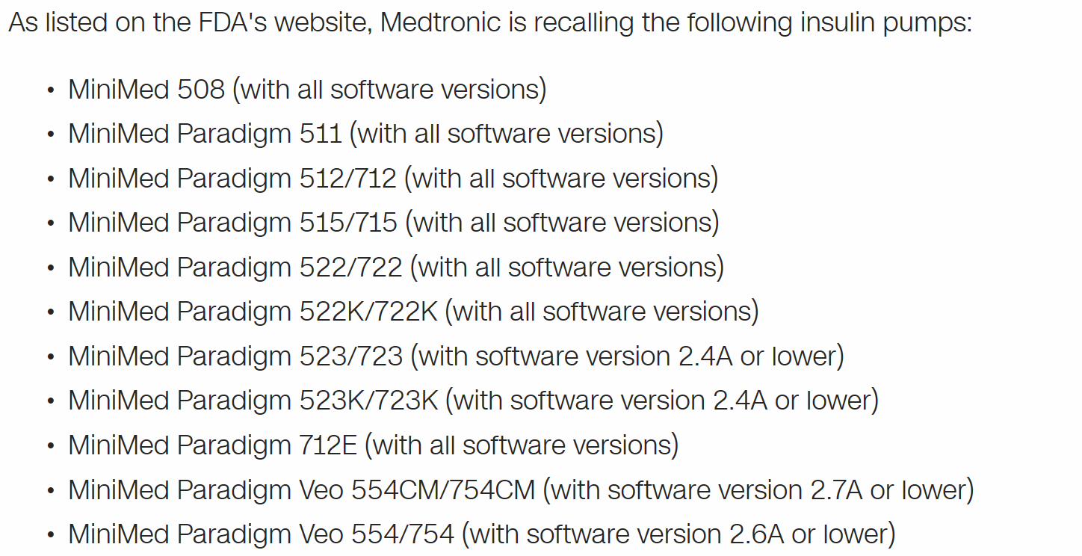
Hardware

Slide 33
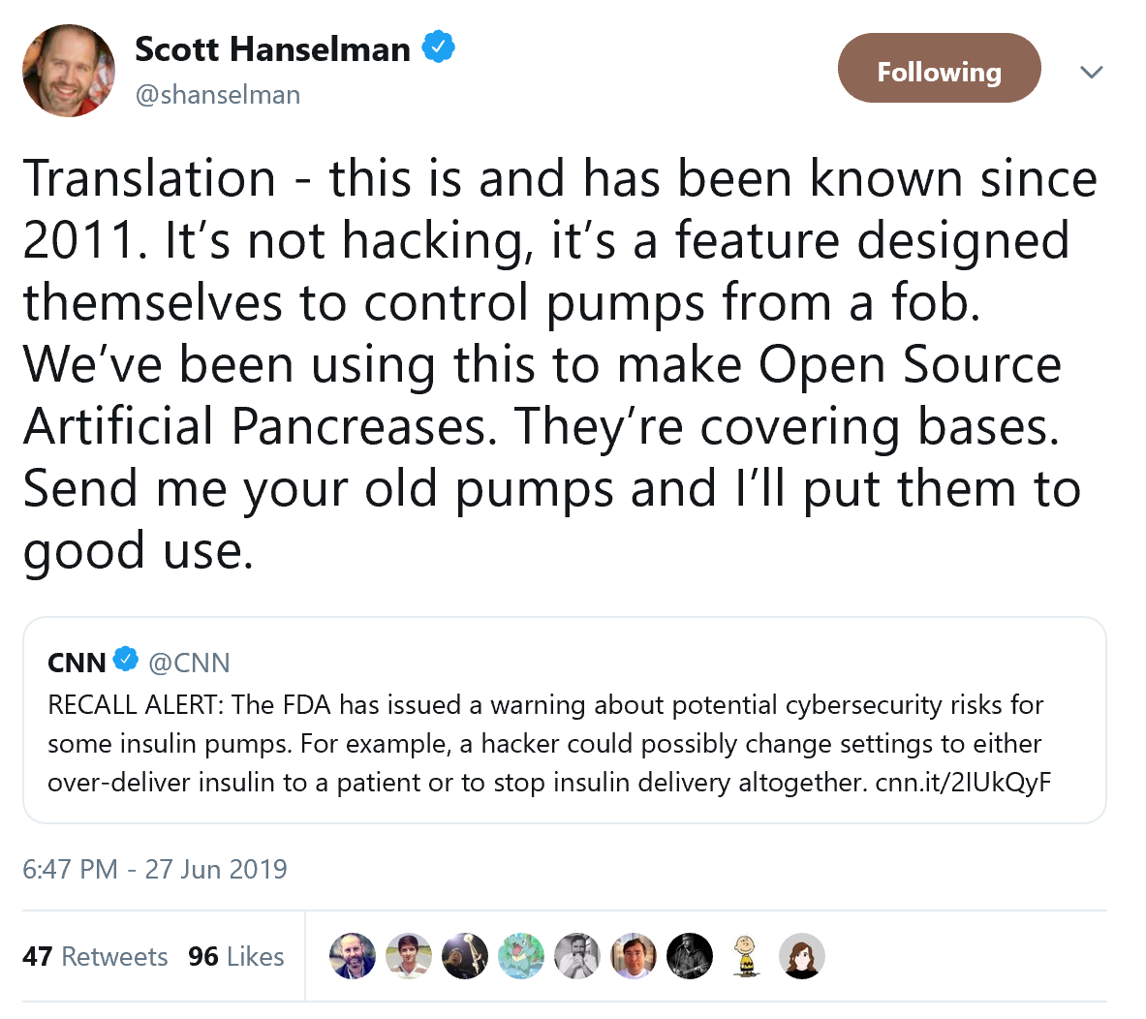
Hardware
Notes:
Scott says they’re covering bases, I said they were covering asses until this article came out three weeks later.

Slide 34
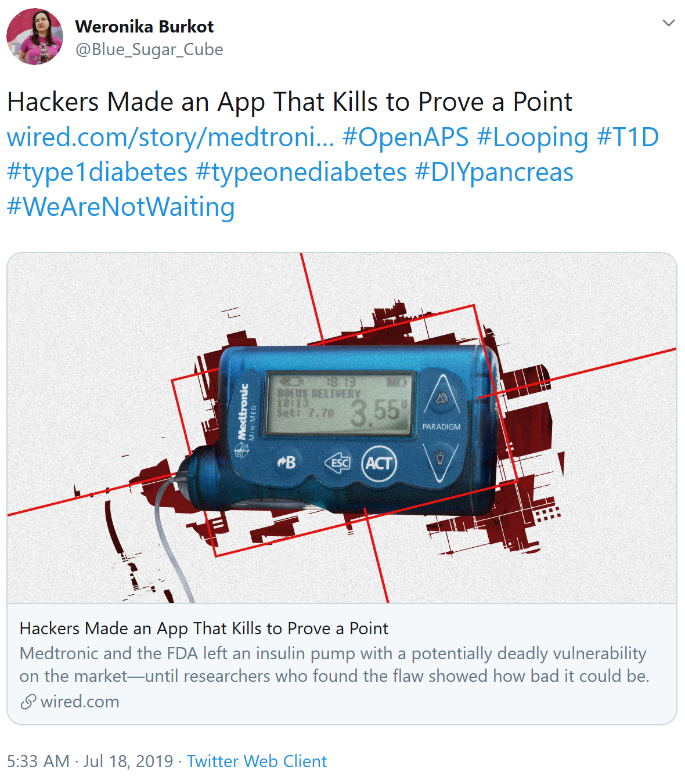
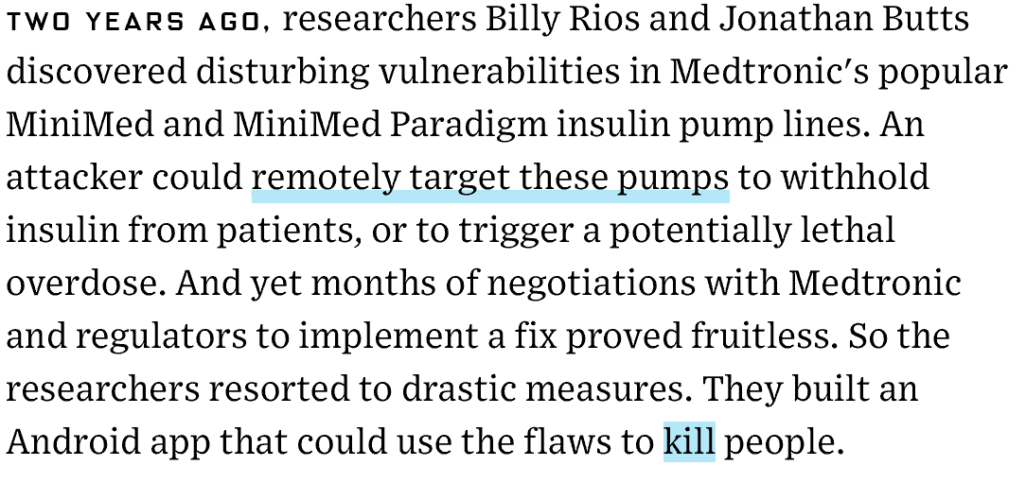
Hardware
Notes:
Recall that these assholes couldn’t have done any prior research or he would have easily stumbled on what we’re going to talk about today, which had been going on for about four years prior without any hospitalizations.

Slide 35
Agenda
whoami?
Introduction to Diabetes
Hardware
Software and Safety
Iterative Improvements
Live Demo
Results
Exponential Growth
Questions?

Slide 36
Software and Safety
Our software solution stack:
Linux
Node and Go
Mongo
Python and Bash
Nightscout is a purpose-built visualization and web-based data warehousing platform built on Mongo and Node designed specifically for remotely monitoring the well-being of a diabetic, whether yourself or those under your care.

Slide 37
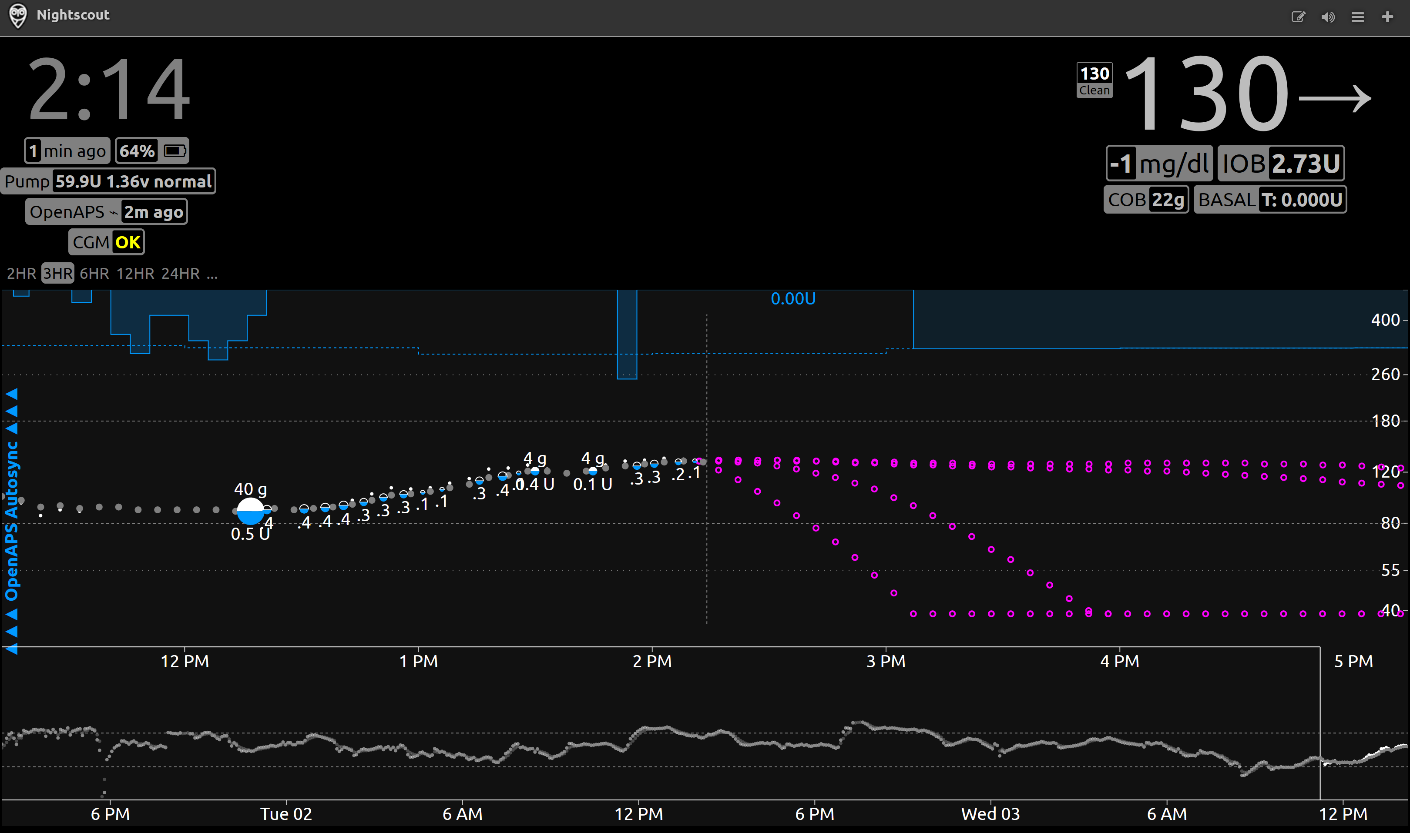
Software and Safety

Slide 38
Software and Safety
Each person builds their own Nightscout instance
Heroku or Azure, free tier plans
You can run it on private infrastructure if you have that option available to you
Nightscout is good for point-in-time representation about things now
Also useful it to give our solution some insight into our actions so it can make treatment decisions
Serves as a great reporting tool that can be used to generate charts and reports to bring to routine medical appointments

Slide 39
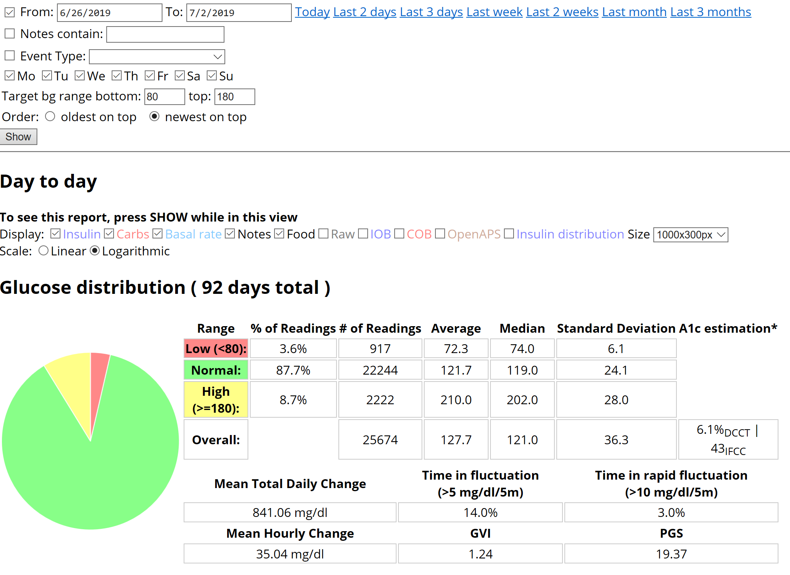

Slide 40
Software and Safety
The Open Artificial Pancreas System, or OpenAPS
Node, Python, Go, and Bash suite of components that runs on Linux
Designed to acquire CGM data, process it using an algorithm and deliver a dosage command to an insulin pump
More than 1,440 people are using this around the world
13.7M person-hours of algorithm experience combined

Slide 41
Software and Safety
A person can be expected to do the equation just several times per day
OpenAPS processes data and can make dosing decisions every five minutes
That’s 288 times per day
Including, most importantly, while the patient is sleeping
Better decision making than the patient because even more can be taken into account
Insulin Absorption Modelling: Uses the manufacturer’s equations to predict impact
Autotune: Tunes the algorithm to carbs and insulin over weeks
Autosens: Tunes the algorithm to your body over the last 24 hours
Advance warnings: Tells you how much to eat as a correction to keep up
Notes:
Autosensitivity/resistance mode (aka “autosens”) is an advanced feature in OpenAPS that you can enable that looks at 24 hours of data and makes adjustments to ISF and targets based on the resulting sensitivity calculations. If you have a dying pump site, or have been sick and are resistant, your ISF is likely to be calculated down by autosens and then used in OpenAPS calculations accordingly. The opposite for being more sensitive is true as well. (Here’s a blog post describing autosensitivity during sick days.)
Autotune, by contrast, is designed to iteratively adjust basals, ISF, and carb ratio over the course of weeks. Because it makes changes more slowly than autosens, autotune ends up drawing on a larger pool of data, and is therefore able to differentiate whether and how basals and/or ISF need to be adjusted, and also whether carb ratio needs to be changed. Whereas we don’t recommend changing basals or ISF based on the output of autosens (because it’s only looking at 24h of data, and can’t tell apart the effects of basals vs. the effect of ISF), autotune is intended to be used to help guide basal, ISF, and carb ratio changes because it’s tracking trends over a large period of time. See below for how it can be used as a manual one-off calculation or in a closed loop setting, along with notes about the safety caps designed to go with it.

Slide 42
Software and Safety
Can normally be expected to wake up at least once or twice every night to alarms requiring action
OpenAPS works to keep the patient in range without intervention
Sleep is one particular area of life that improves dramatically almost immediately
A sleeping patient isn’t eating so it’s easy for the system to maintain them within range
Good time in range, especially at night, improves A1c measurement without any work on their part as well
Notes:
I went from getting no more than six uninterrupted hours of sleep at a time to, on the first day, sleeping for ten straight hours

Slide 43
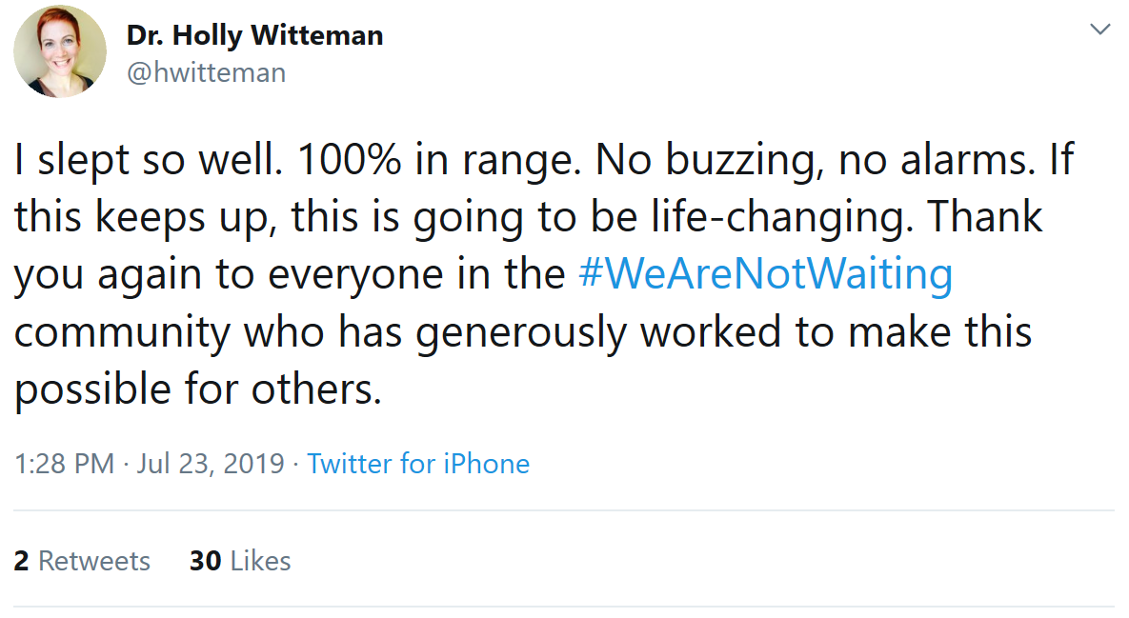
Software and Safety

Slide 44
Software and Safety
While under development, users and maintainers have been building the plane while flying it.
Safety is a critical factor in the way changes and features are implemented because it’s important that this doesn’t cause someone to be hospitalized
Several checks and double checks are made before making dosing decisions
Fallback behaviors are defined
Features that may impact the algorithm are scrutinized heavily

Slide 45
Software and Safety
New failure modes are well defined:
OpenAPS is out of range of the source of glucose readings
OpenAPS is out of range of the insulin pump
A process running on the OpenAPS device dies and needs to be restarted
Power loss in one or more devices
Commands are delivered so the pump reverts to normal, factory behavior when one of these failure modes occurs
During sleep the manufacturer-provided CGM receiver can be used as a secondary safety system to sound an alarm if the blood sugar levels go out of a defined range

Slide 46
Software and Safety
Normal care routines operate by making large drastic changes that can’t be undone in both carbohydrates and insulin intake
Eating 60g of carbohydrates? That might be 6.6U of insulin
One indirect safety factor that was discovered through use of the system makes sense when thought to its logical conclusion:
Making very small changes every five minutes allows the system to self-correct after just five more minutes if the situation should suddenly change
Sudden rapid rise? Add more insulin
Sudden unexpected descent? Suspend delivery

Slide 47
Software and Safety
Key during meals: don’t take the entire insulin dose at the beginning of a meal and hope the body doesn’t process the insulin faster than the carbohydrates
Taking the whole dose has a non-zero chance of causing low blood sugar
OpenAPS mimics the pancreas’s normal function
Slowly doses insulin as the body processes carbohydrates, keeps the patient’s blood sugar from extremes
Lesser amounts of insulin in a person’s system at any given time reduces the overall likelihood they experience blood sugar drop

Slide 48
Agenda
whoami?
Introduction to Diabetes
Hardware
Software and Safety
Iterative Improvements
Live Demo
Results
Exponential Growth
Questions?

Slide 49
Iterative Improvements
Several implementations built over the last three years
Assemblies range in size
Large, requiring a shave kit bag modified to strap the components to the inside
Small, enough to fit unnoticed in a pant leg pocket.
Each iteration and choice of component reduced the size, improved portability and battery life
Building the plane while flying it
Contributed to OpenAPS projects adding improved compatibility with FDA-certified devices, reduced friction around installing the system

Slide 50
Iterative Improvements
Implementation and improvement of an interactive setup script
Maximum flexibility around connectivity
The systems work without requiring a connection to the Internet when one isn’t available
When Internet connectivity returns the device drops all of the data from the time it spent disconnected into Nightscout to aid in later analysis
As long as it gets time when it starts up it doesn’t need to be connected to the Internet continuously

Slide 51
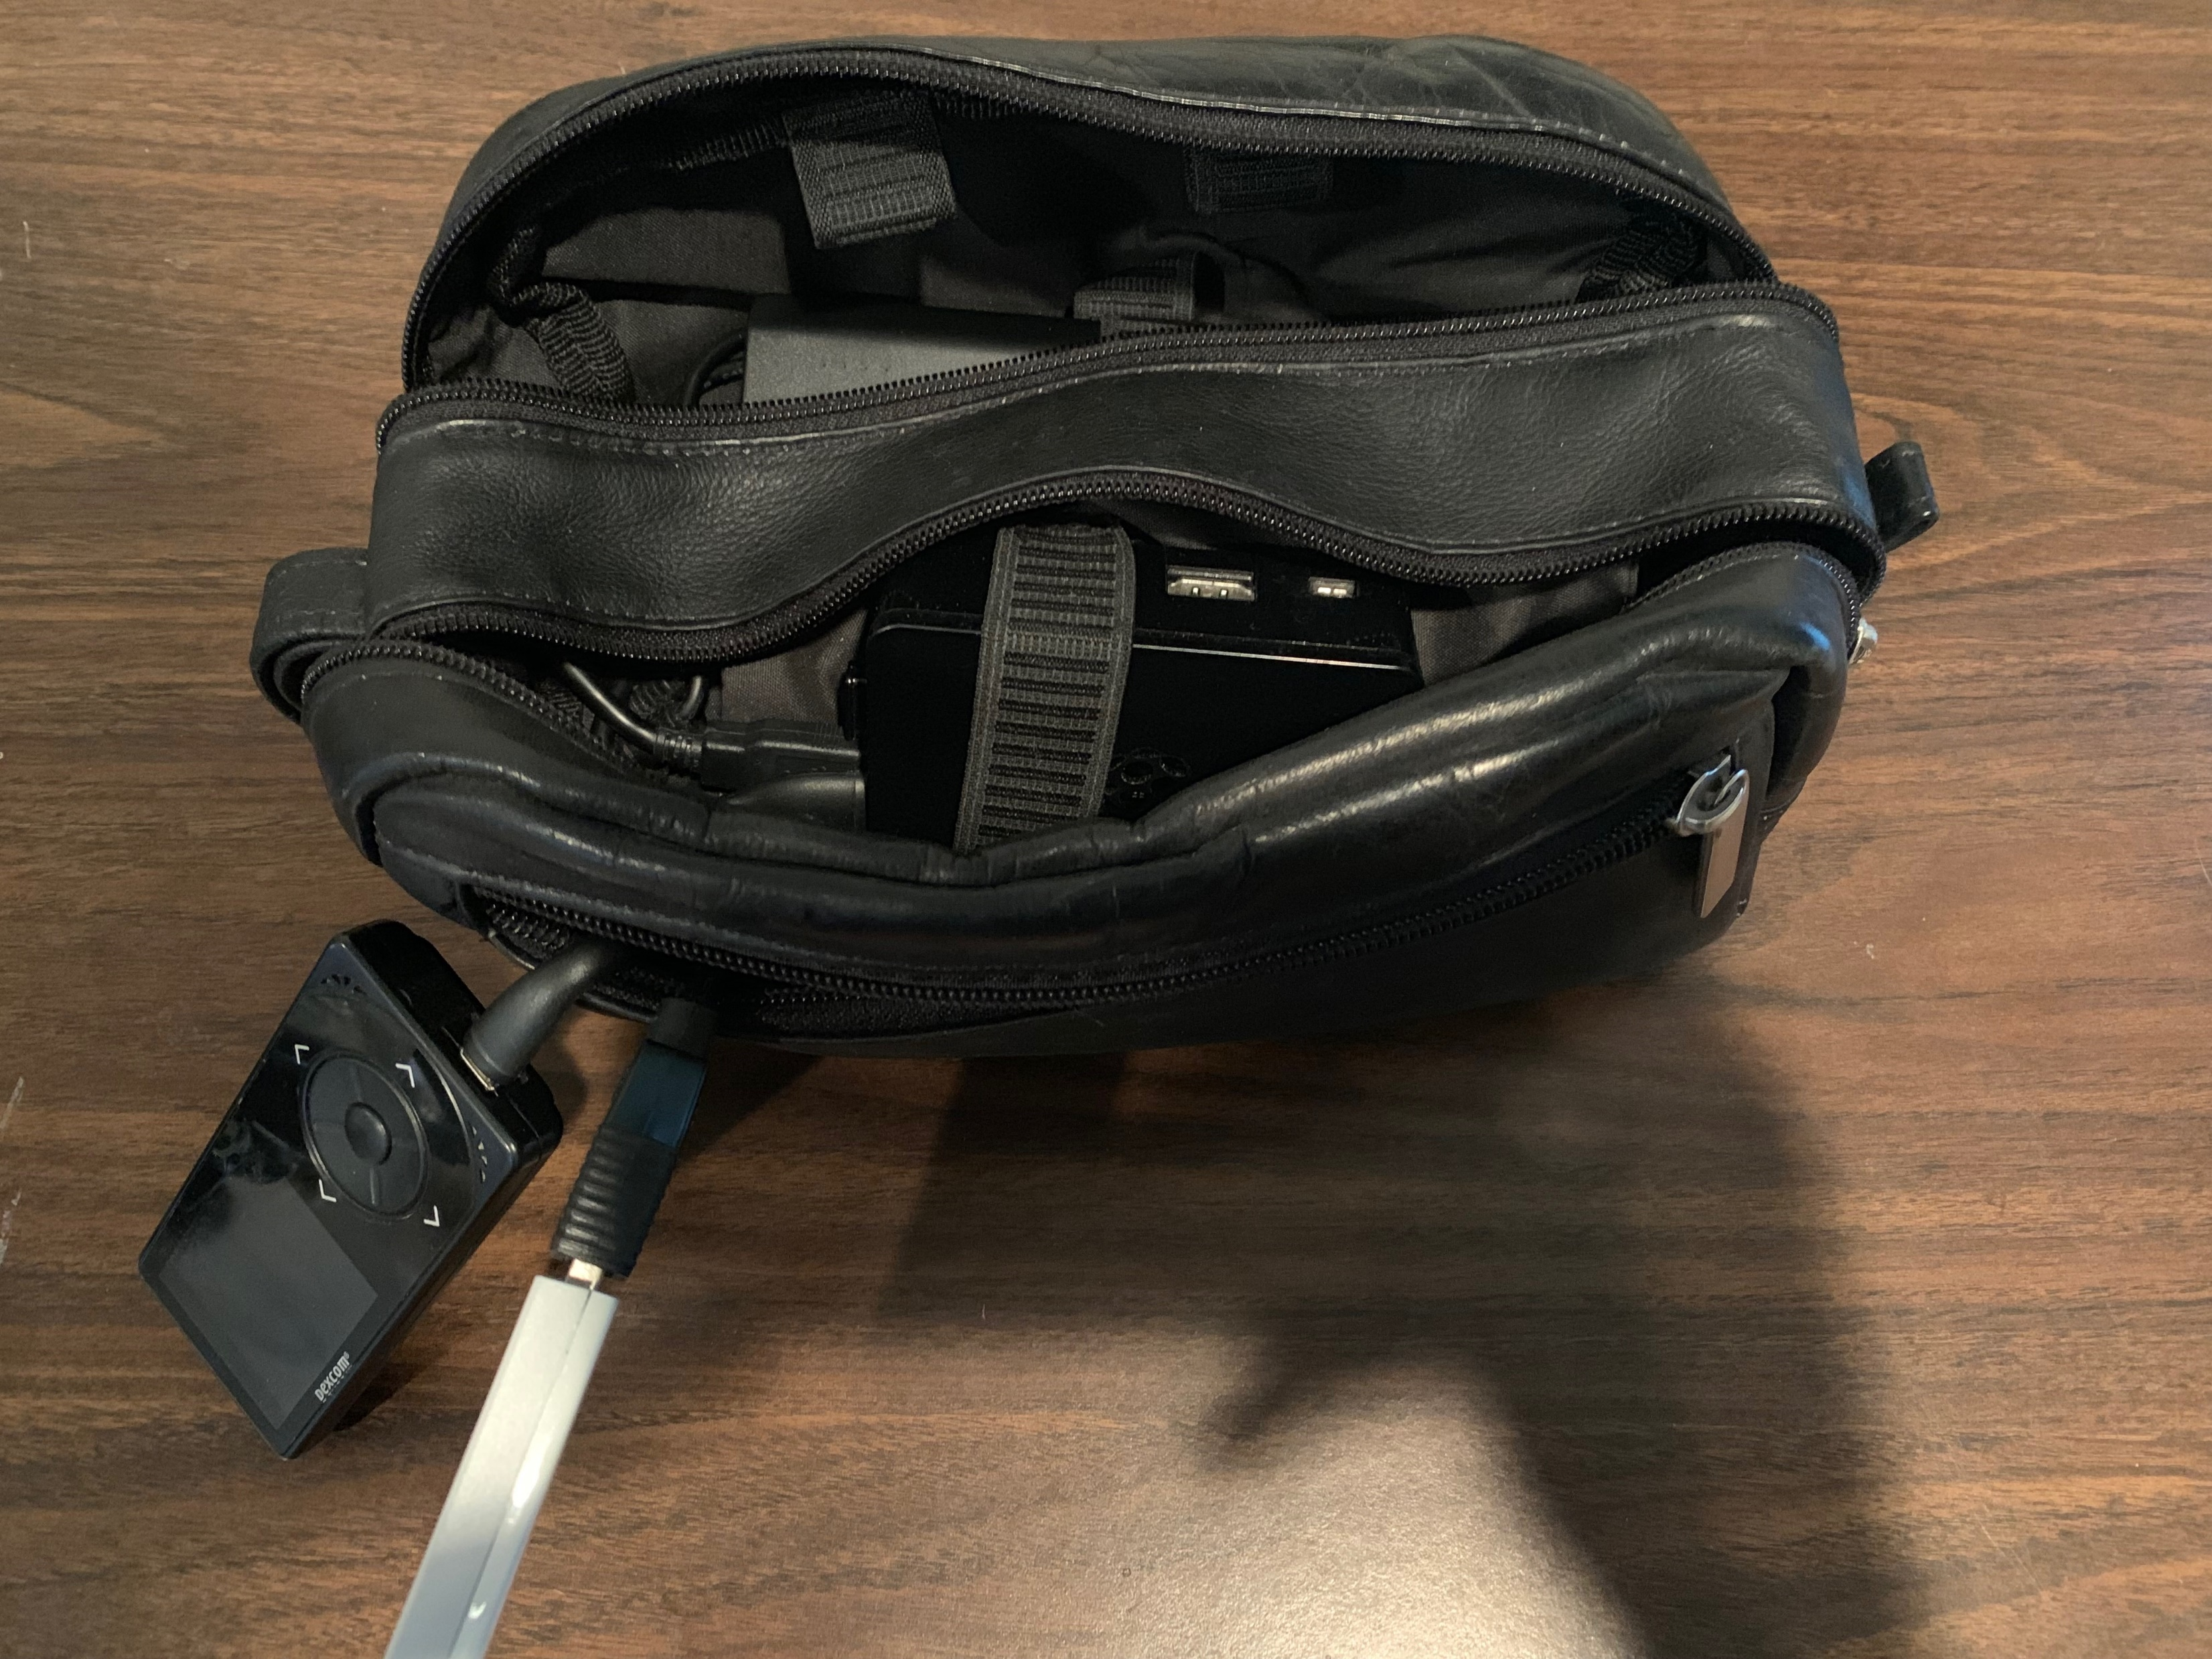
Iterative Improvements
Notes:
I don’t know whether to attribute the antenna design to malice or incompetence, because 5 feet away it barely works

Slide 52
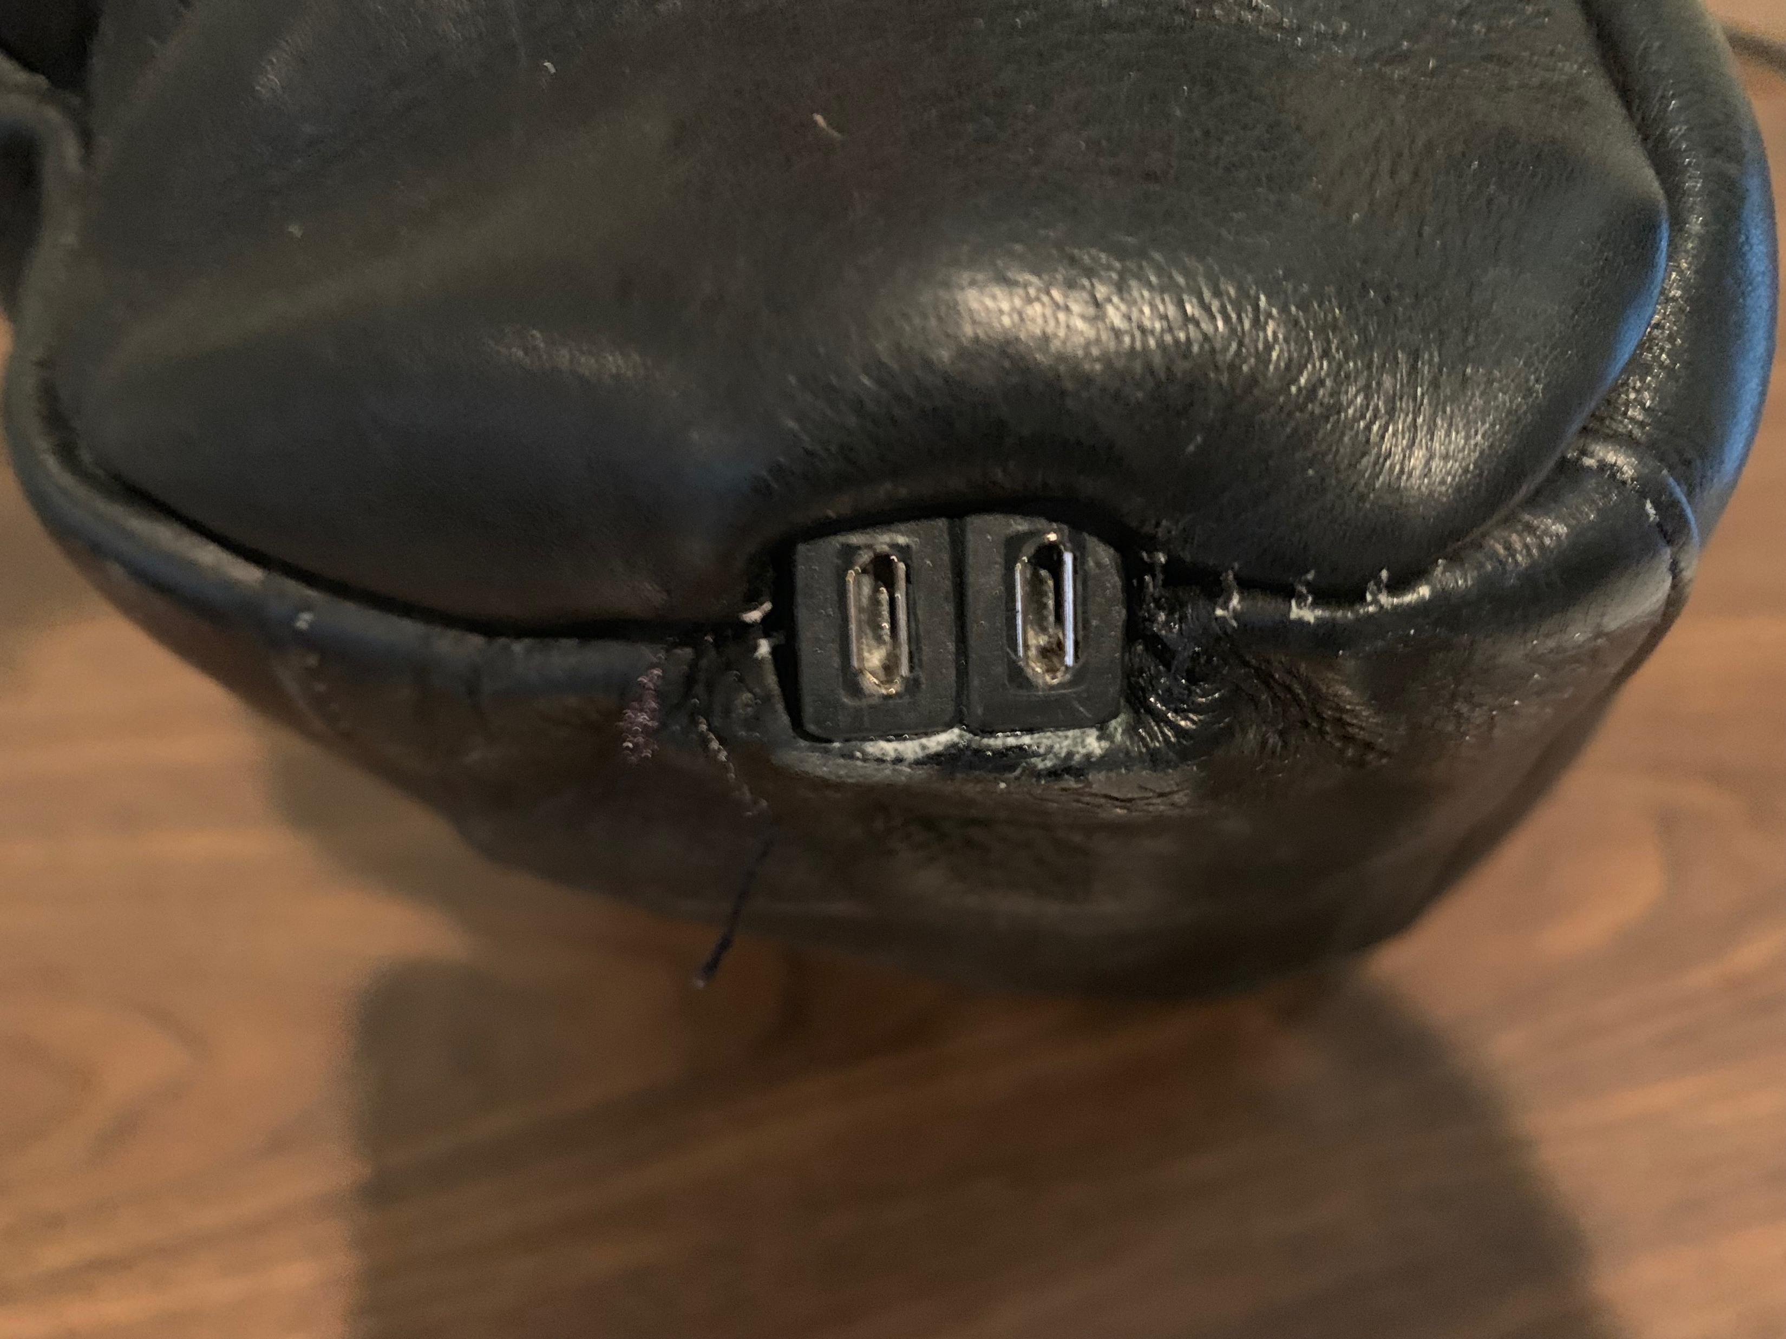
Iterative Improvements

Slide 53
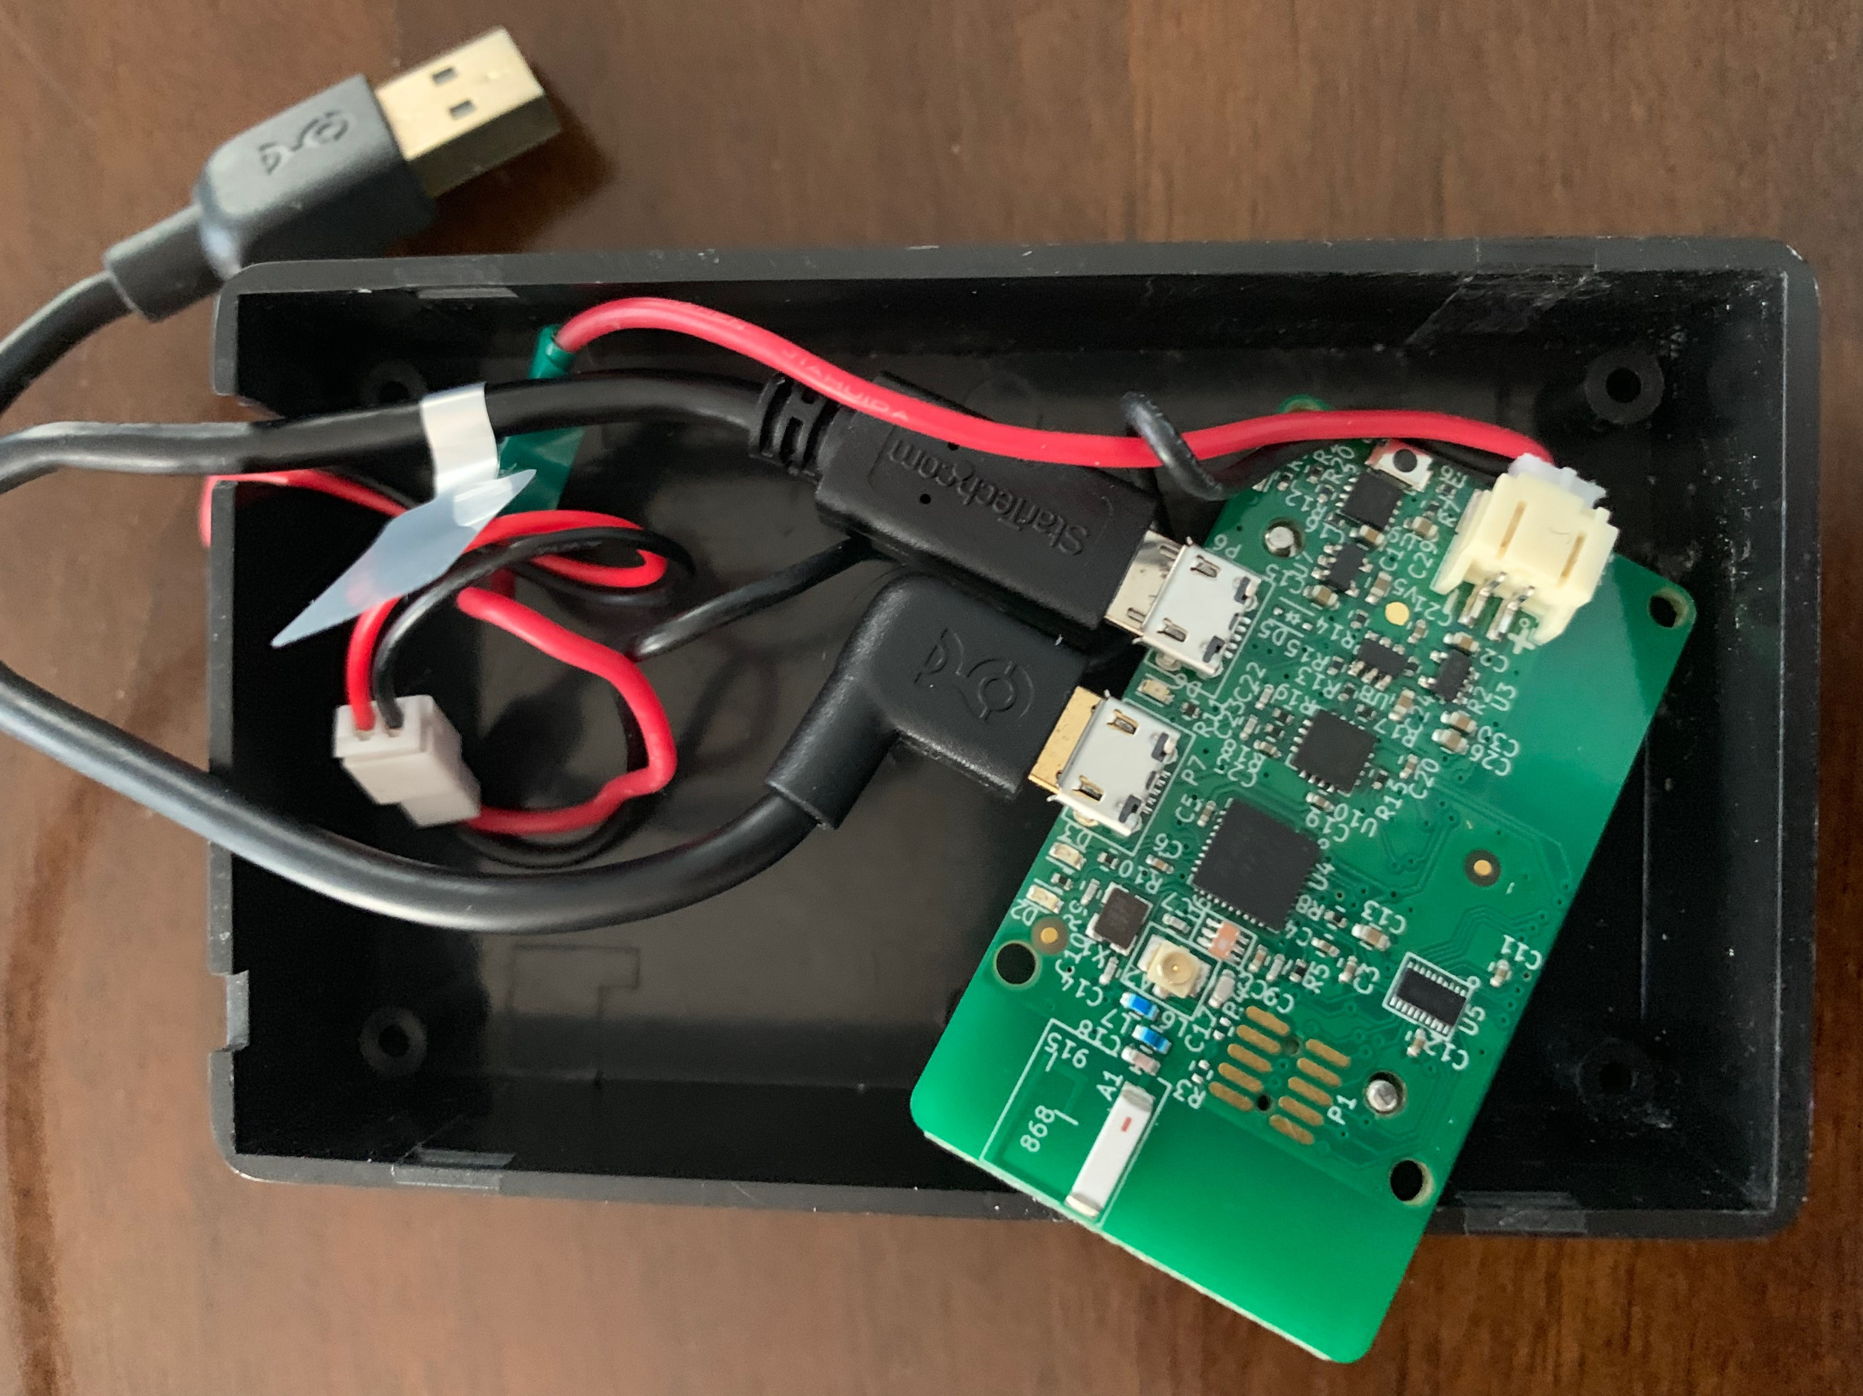
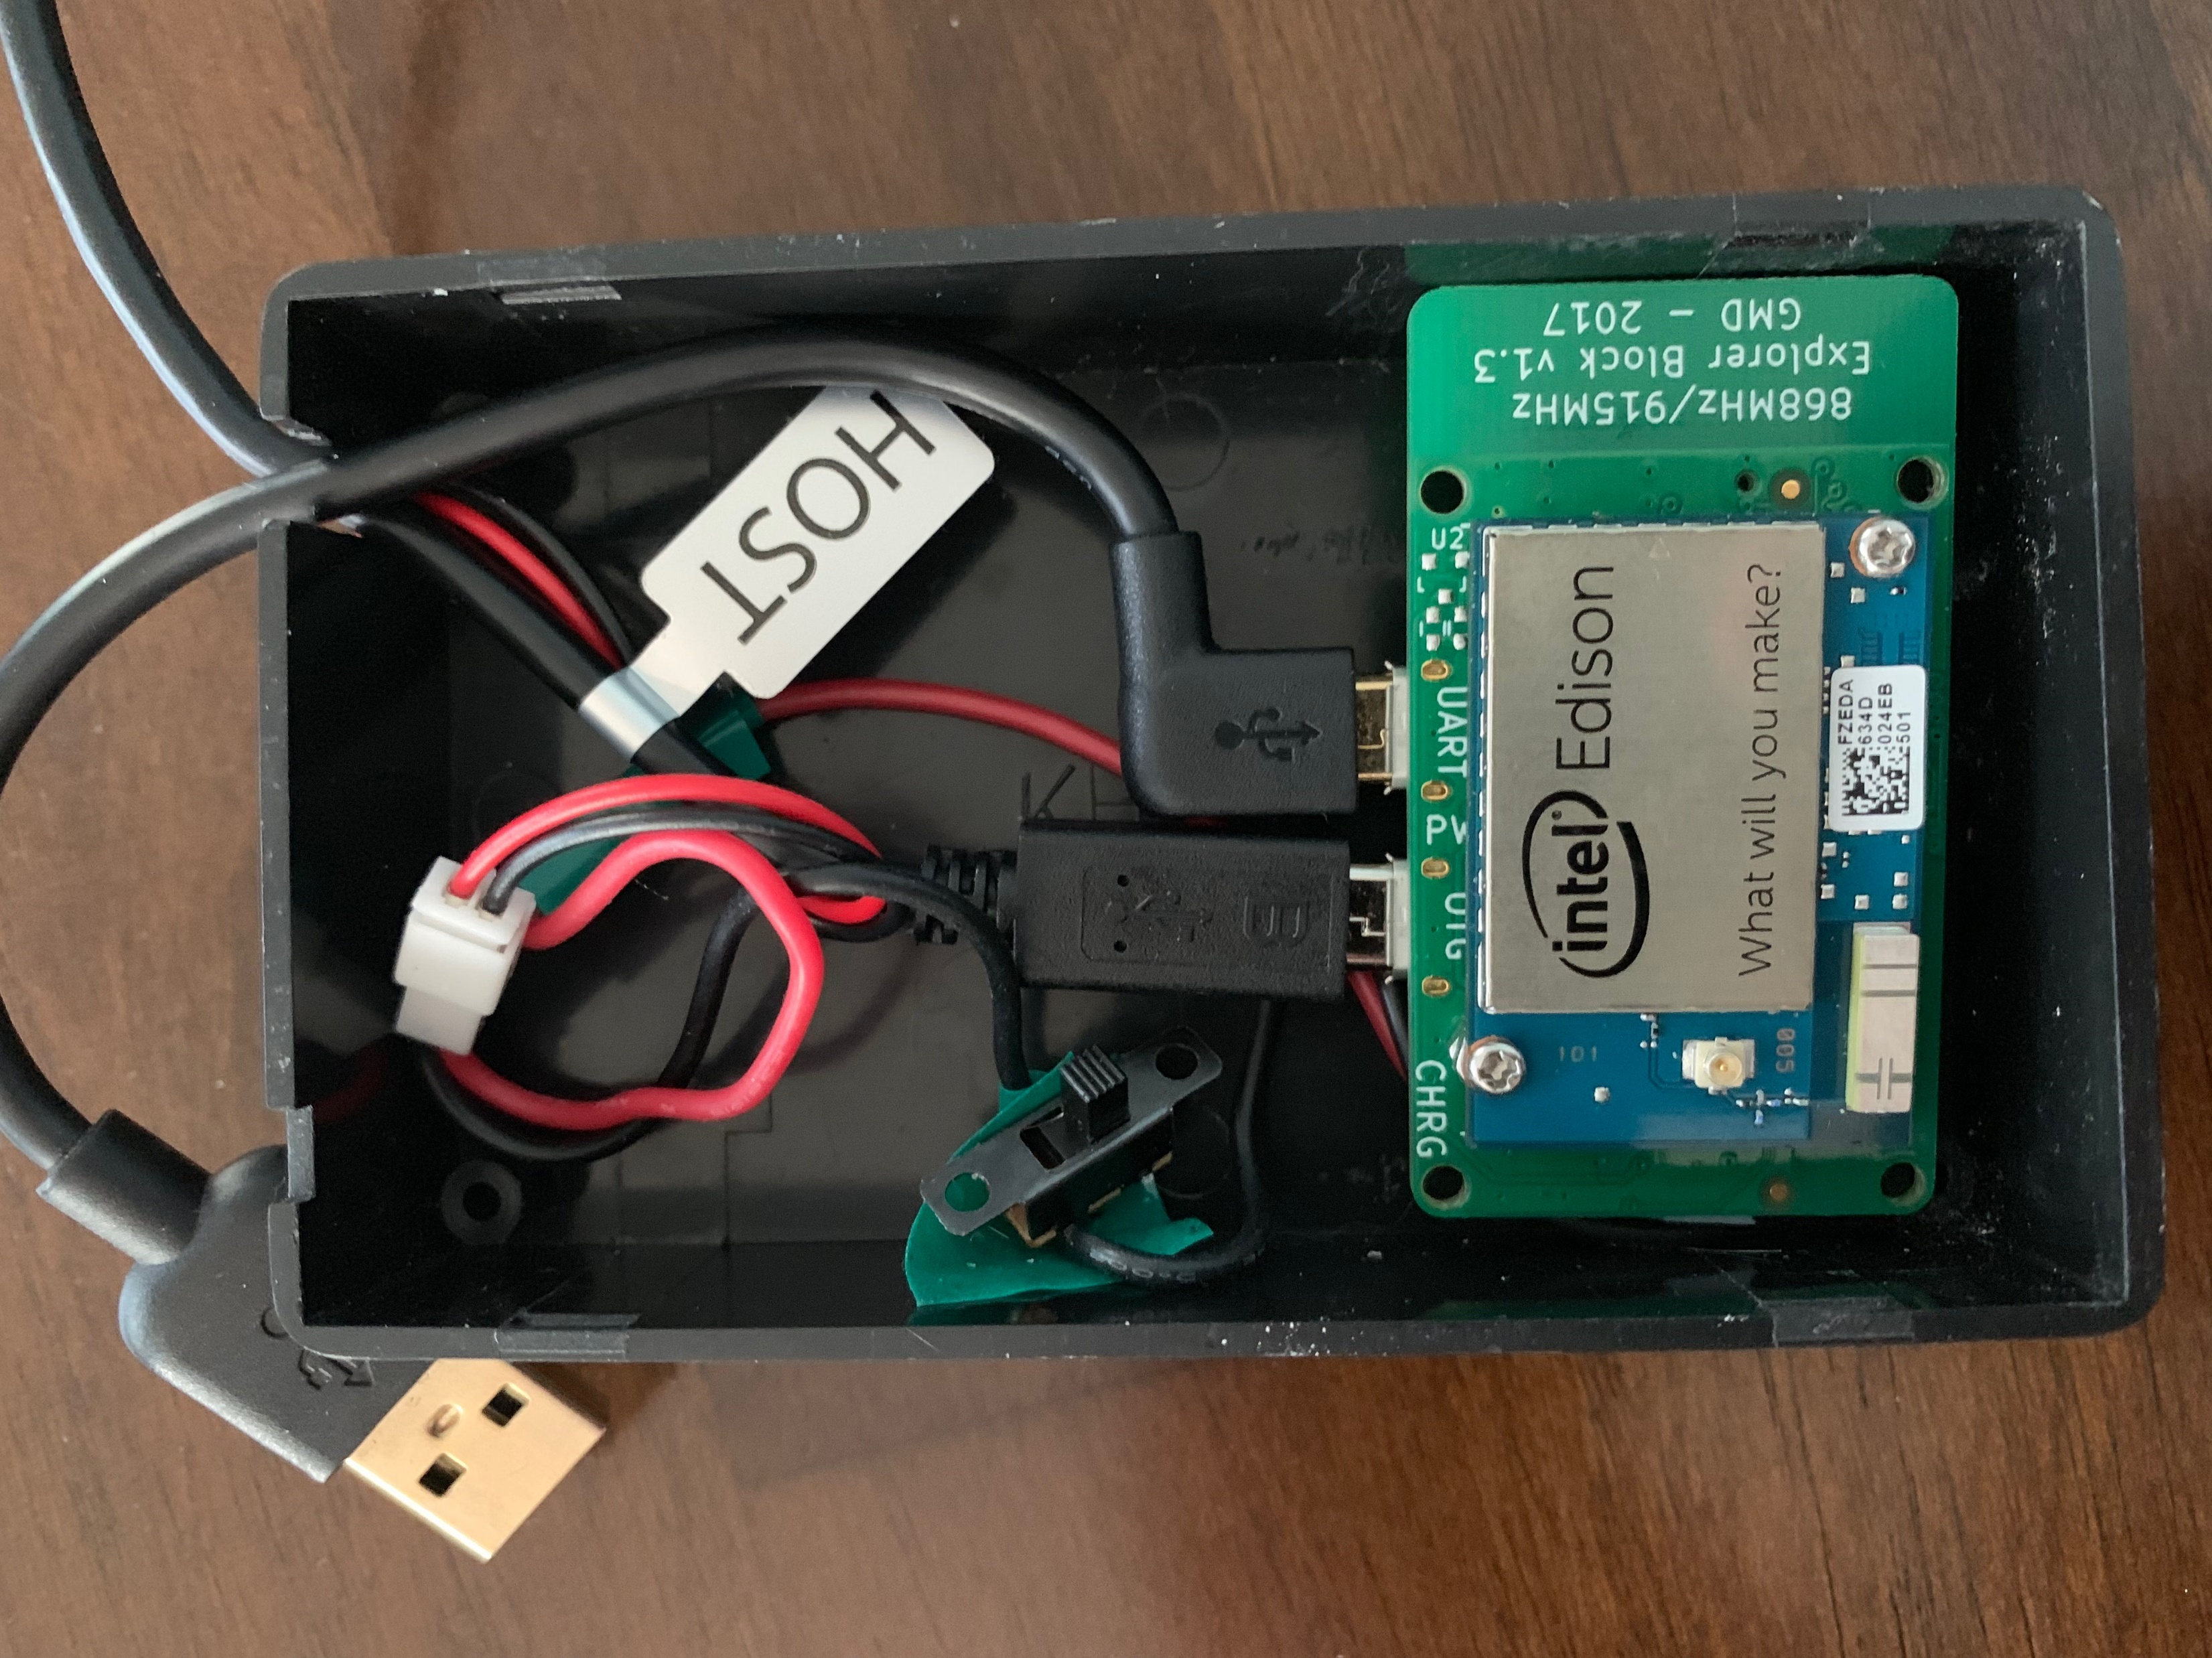
Iterative Improvements

Slide 54
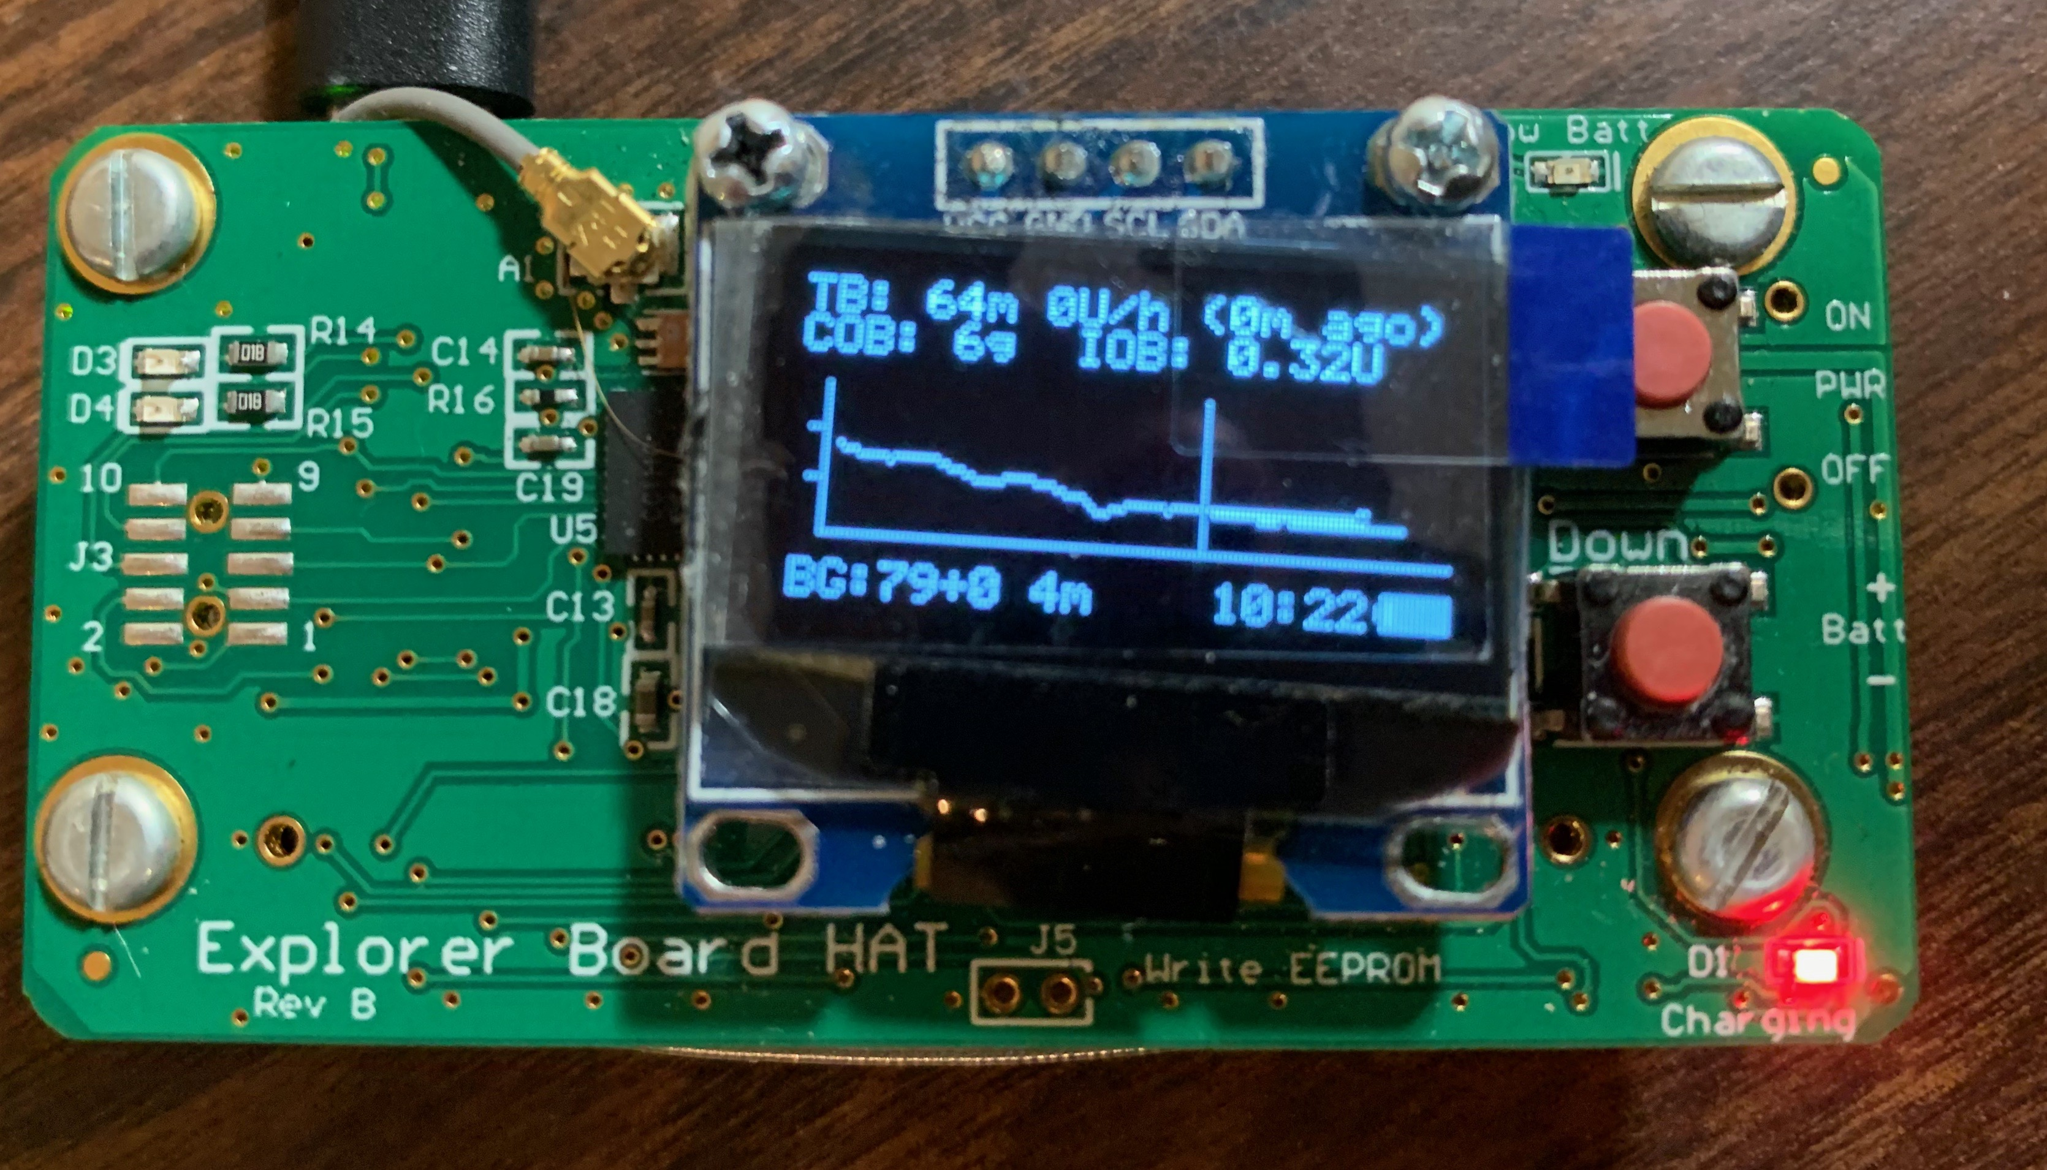
Iterative Improvements

Slide 55
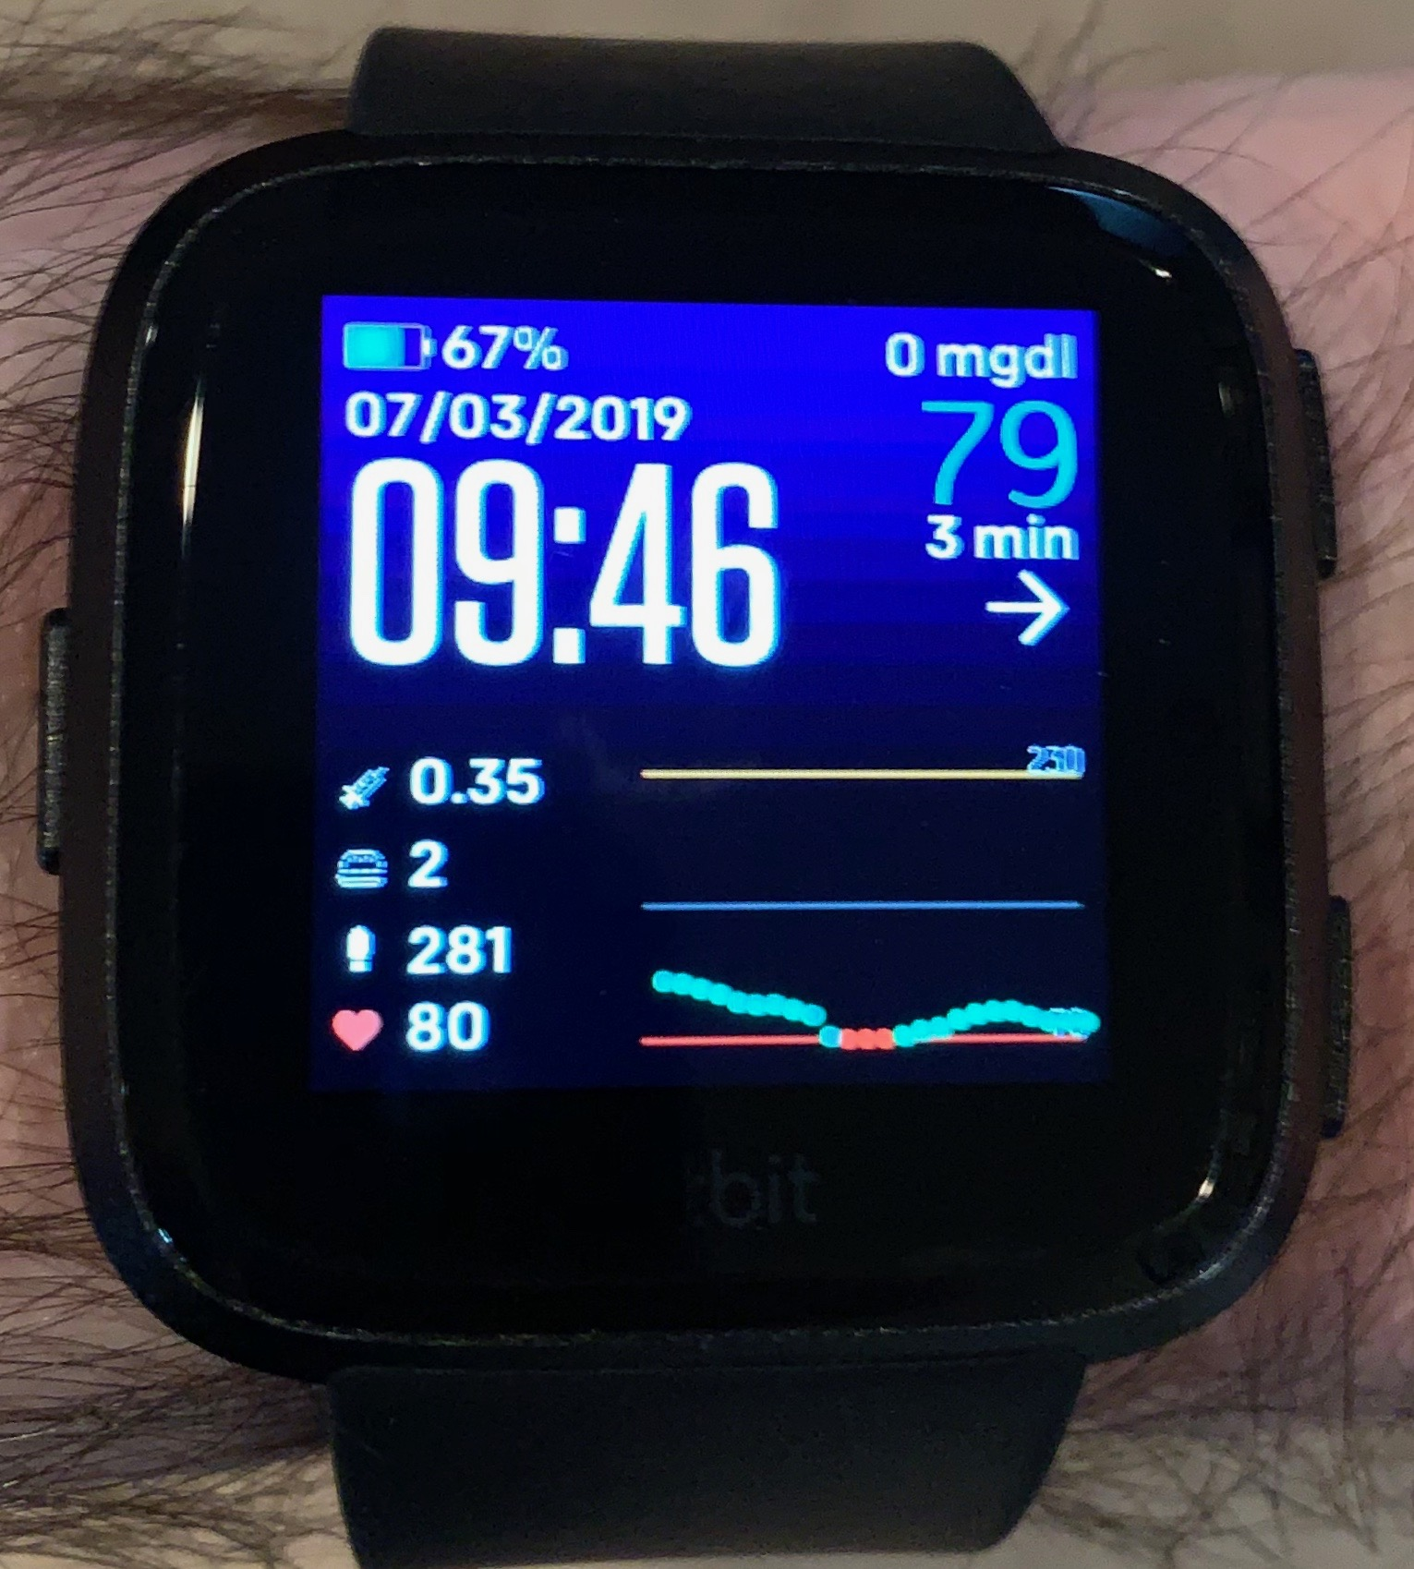
Iterative Improvements

Slide 56
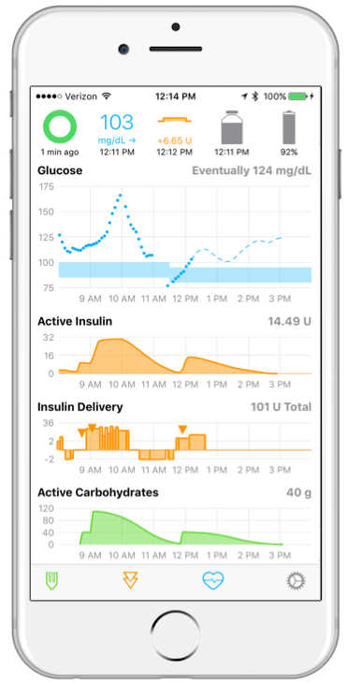
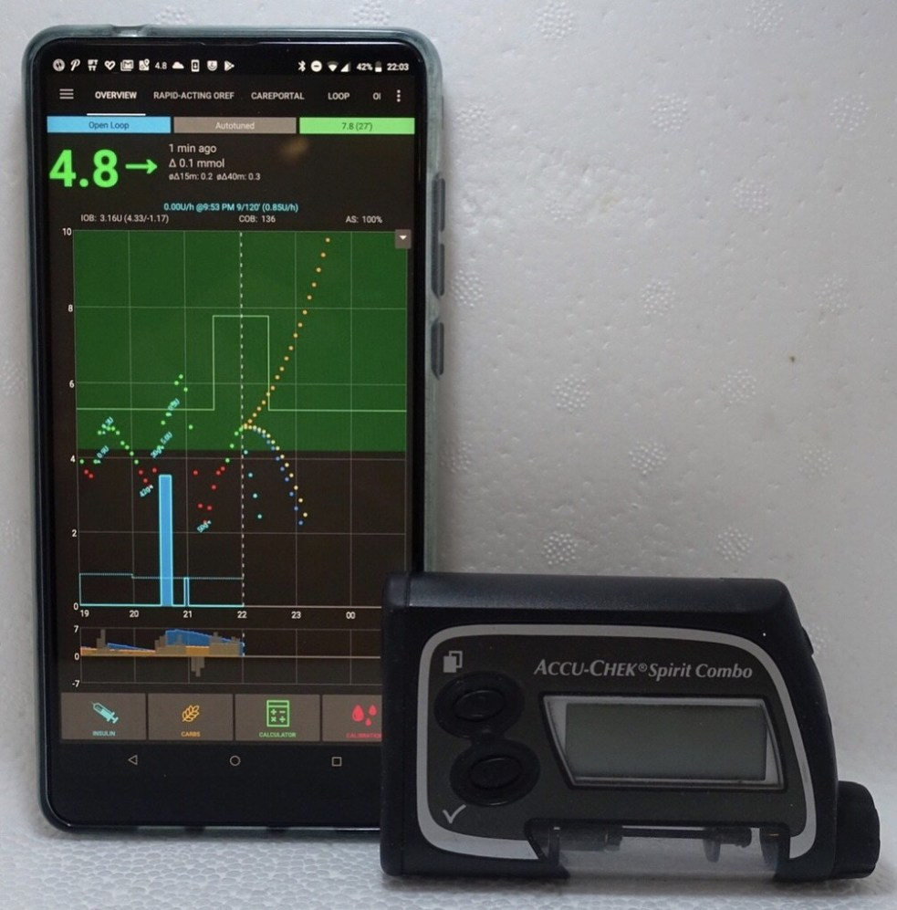
Iterative Improvements
Notes:
Loop, AndroidAPS

Slide 57
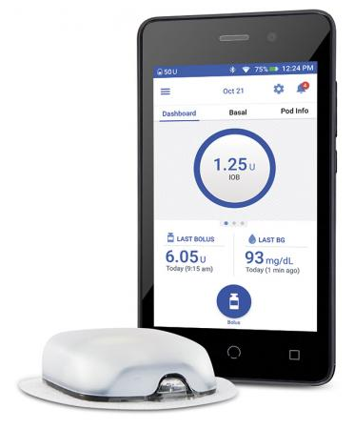
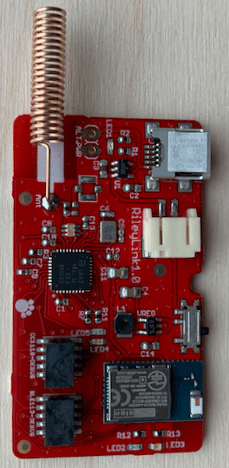
Iterative Improvements
Notes:
Omnipod is IN WARRANTY

Slide 58
Agenda
whoami?
Introduction to Diabetes
Hardware
Software and Safety
Iterative Improvements
Live Demo
Results
Exponential Growth
Questions?

Slide 59
Live Demo
Show Nightscout

Slide 60
Live Demo
Show loop log
Show CGM log

Slide 61
Agenda
whoami?
Introduction to Diabetes
Hardware
Software and Safety
Iterative Improvements
Live Demo
Results
Exponential Growth
Questions?

Slide 62
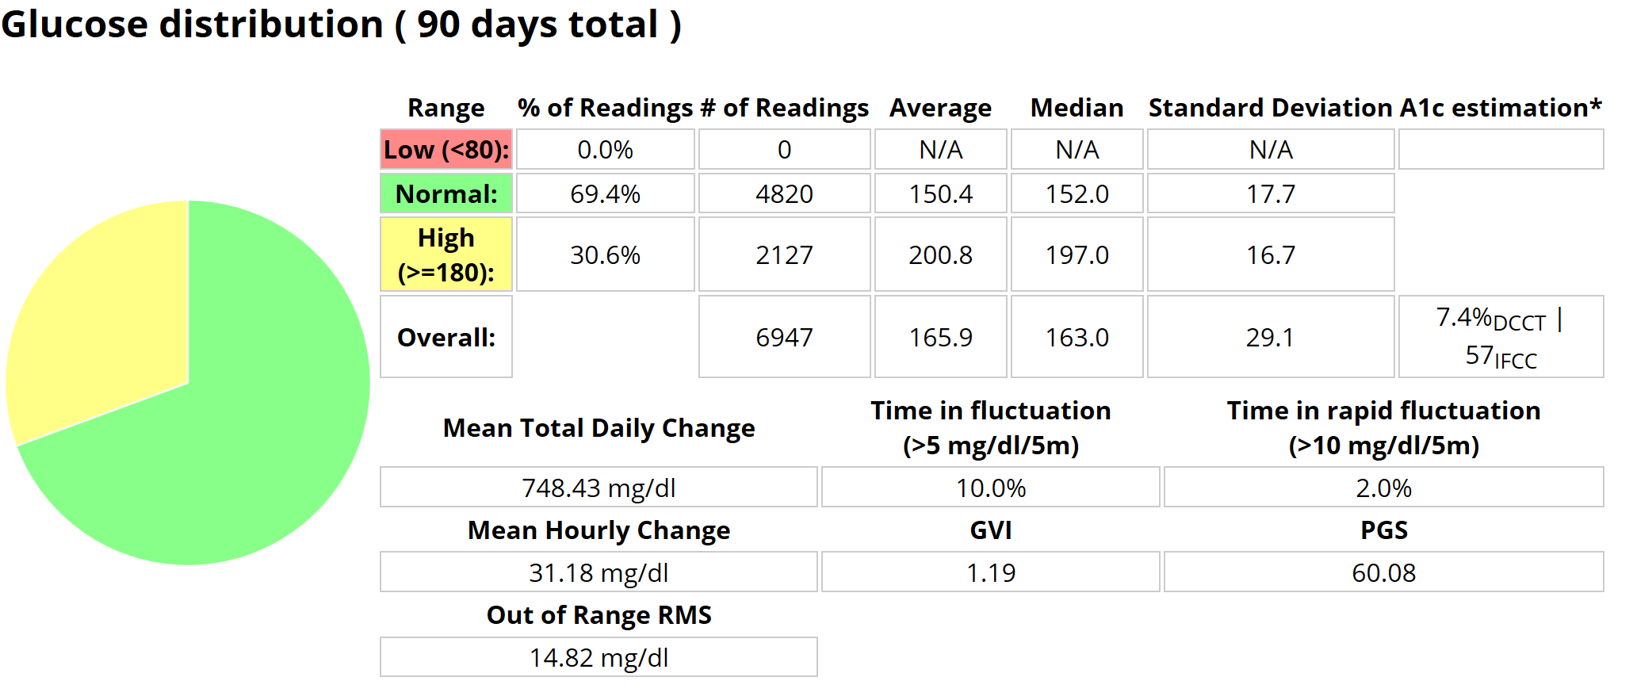
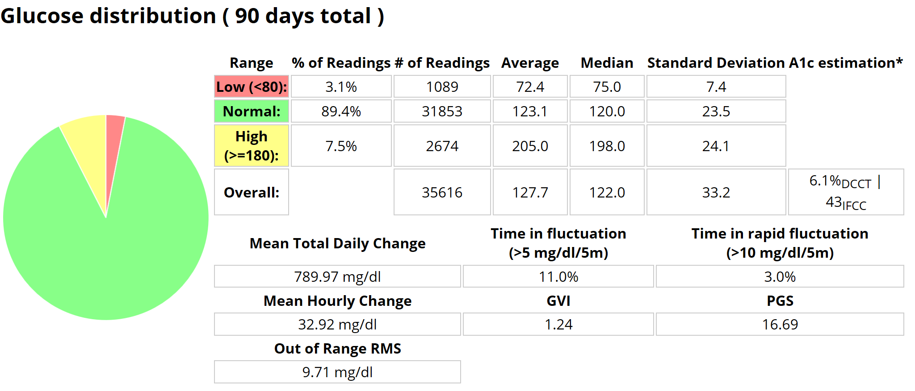
Notes:
The lower your A1c the more likely you are to be in range, but lower A1c is also associated with hypoglycemia

Slide 63
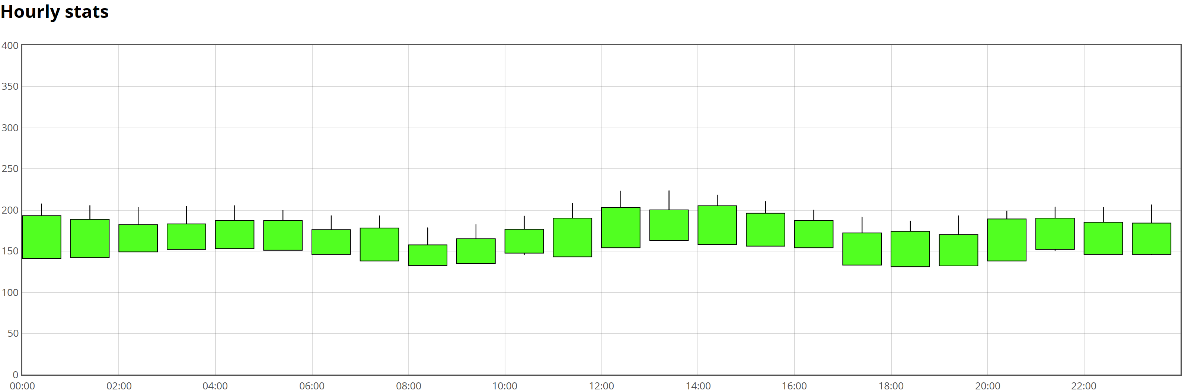
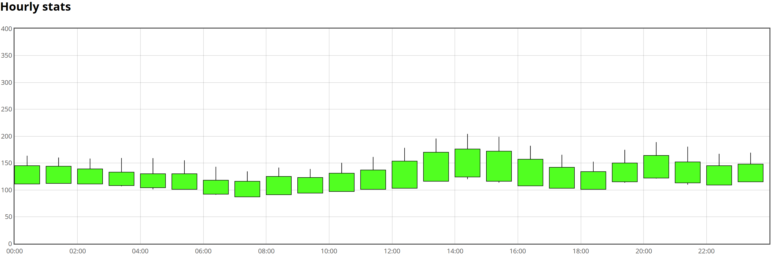
Notes:
Notice that in the first graph from this time in 2016 the bars are primarily 150 – 200
In 2019 over the same three month period primarily between 100 – 150, and rises over that are mostly after lunch and dinner with a quick return to being in range

Slide 64
Results
Date | A1c | A1c Est
9/4/2008 | 16.5
11/24/2008 | 6.2
3/16/2009 | 7.0
10/29/2009 | 7.1
5/19/2010 | 6.9
9/8/2010 | 6.9
4/28/2011 | 7.1
8/8/2011 | 7.2
9/18/2012 | 6.6
4/30/2013 | 6.9
9/10/2013 | 7.1
6/17/2014 | 7.3
1/29/2015 | 6.6
6/2/2015 | 6.7
7/29/2015 | 7.2
12/10/2015 | 7.5
3/15/2016 | 7.3
11/29/2016 | 6.7 | 6.5
8/8/2017 | 6.2 | 6.4
2/9/2018 | 6.2 | 6.4
1/22/2019 | 6.3 | 6.1
Notes:
What is a normal A1c
What was happening that made my A1c crawl up
Talk about how much less work I do: snacks before bed, not going to bed at a higher level, just let OpenAPS handle my meals and I just look at the numbers to make sure what’s going on generally seems right
But let’s talk about industry changes

Slide 65
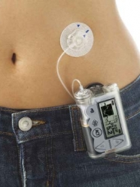
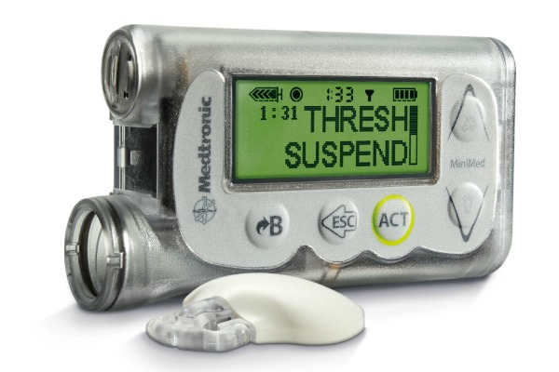
Results
Industry changes
Previously all integrated systems were monolithic systems
Notes:
We talked about some set backs before, but let’s talk about some achievements.
Talk about sensor inaccuracies and how it would cause even more wakeups
These components communicated with only each other, proprietary RF protocol – how much does this cost today?

Slide 66

Results
Industry changes
Previously all integrated systems were monolithic systems

Slide 67
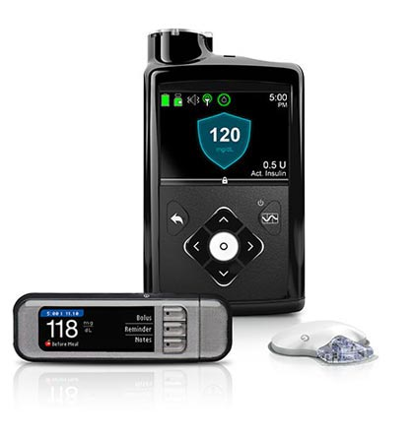
Results
Industry changes
Previously all integrated systems were monolithic systems
Notes:
It doesn’t suspension without freaking out and it’ll slightly adjust your background level to keep you in range
But it’s not tunable and this is a very person-specific disease
It doesn’t handle meals for you, you’re making those drastic changes to your body all at once with no takebacks
And 40% of people leave this system because it doesn’t work consistently enough to be worth the trouble it takes to keep it on automode

Slide 68
Results
Industry changes
Discrete CGM, pumps, and algorithms that all work without collective FDA approval
iCGM
Dexcom G6 is the first certified product
ACE (Alternate Controller Enabled)
An insulin pump, but works with an iCGM and iController
Tandem t:slim X2 is the first certified product
iController
The algorithm, brings together iCGM and ACE to autopilot the plane for the patient
No certified products yet, but Tidepool is trying to get an FDA certified version of Loop, Tandem is attempting to push an integrated TypeZero product at the end of the year
Plug-and-Play is important, and once certified the FDA won’t get in the business of dictating which products can interoperate with which other products as long as each compoment meets the qualifications are met

Slide 69
Results
#WeAreNotWaiting
Notes:
And I mentioned we’ve all heard that there will be a cure in five years, and people just got tired of being fed that line
None of this would have happened in just the last few years if we remained complacent with clunky 1990s garbage tech, and the people, who are not doctors, who started it changed the face of an entire field of medicine

Slide 70
Agenda
whoami?
Introduction to Diabetes
Hardware
Software and Safety
Iterative Improvements
Live Demo
Results
Exponential Growth
Questions?

Slide 71
Exponential Growth
Everyone needs insulin, this is a biological fact
Lack of the hormone is not a question of lifestyles, choices, or what the person could have done better
This lightning strike could happen to anyone in this room
People without it die, no question
Just like water
Just like air
Most have it, some don’t: creates an economic opportunity
Notes:
So when predatory prices are levied on this drug, it’s the financial form of:

Slide 72
Exponential Growth
Your money or your life, kid
Notes:
So when you can’t afford it you try to ration it, and people die this way

Slide 73
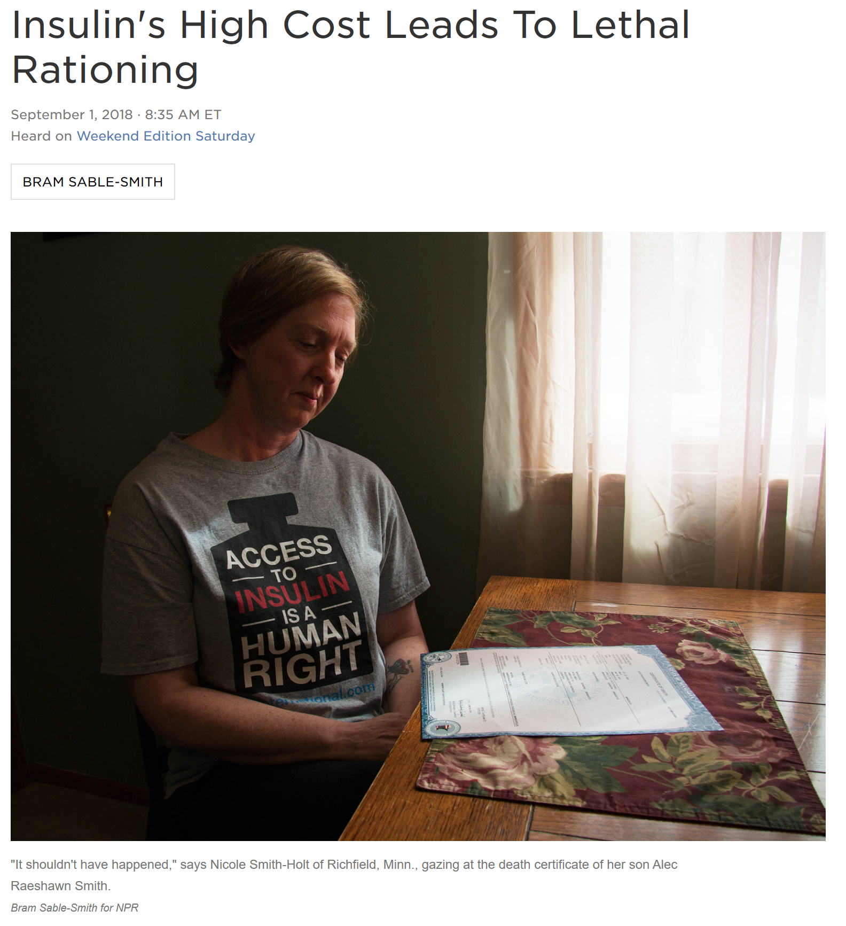
Exponential Growth

Slide 74
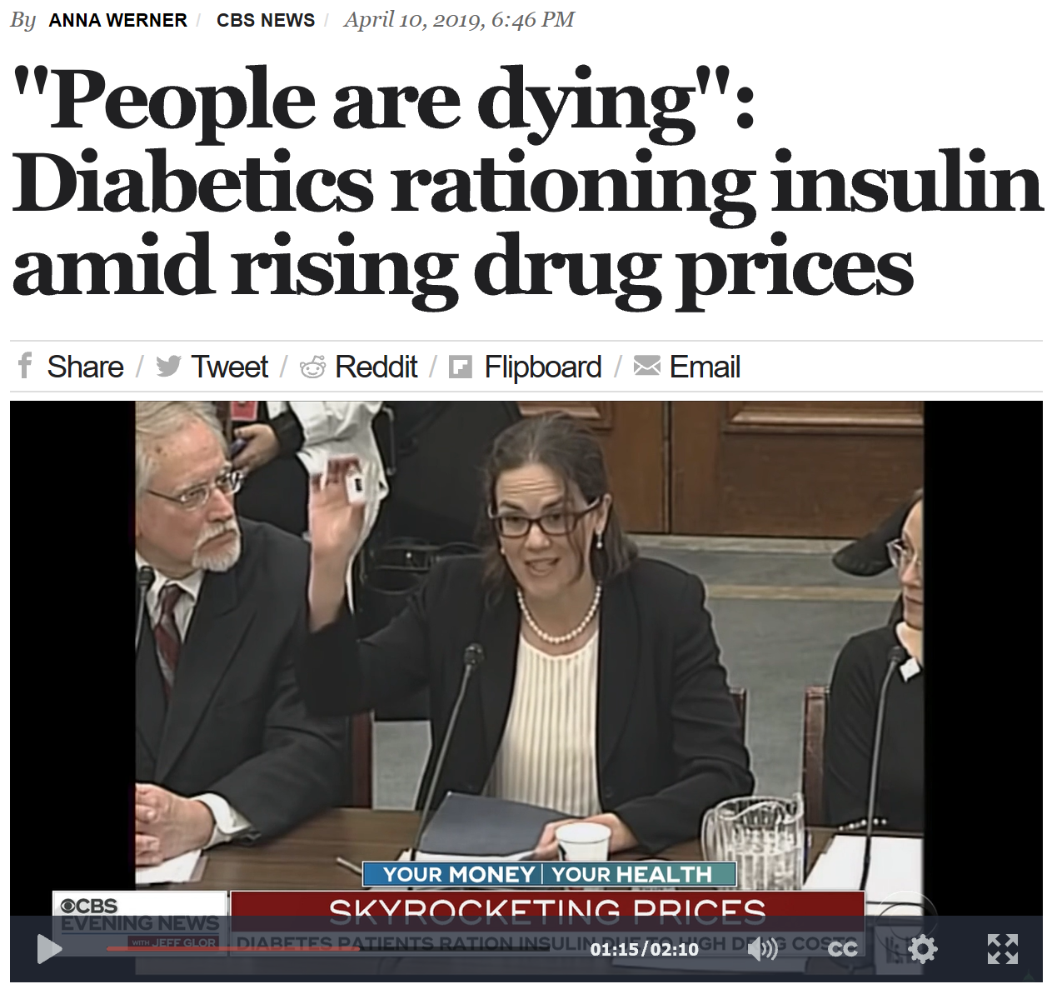
Exponential Growth
Notes:
GoFundMe for insulin is like a goddamn war zone, and in June three people under the age of 25 just in California died because of rationing

Slide 75
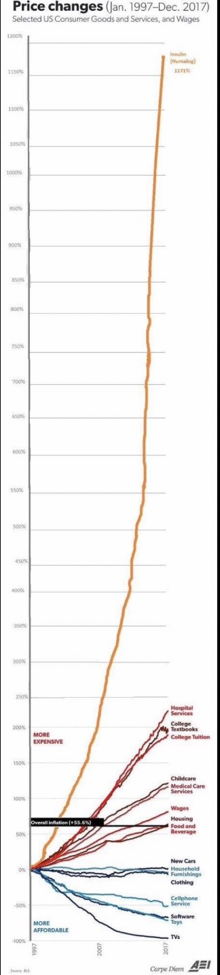
Exponential Growth
Notes:
Cars, clothing, housing, wages, child care, general medical care, college and text books
1175% for the same drug, same formulation, 20 years later

Slide 76
Exponential Growth
Notes:
Cars, clothing, housing, wages, child care, general medical care, college and text books
1175% for the same drug, same formulation, 20 years later

Slide 77

Exponential Growth

Slide 78
Acknowledgements
Ben West (@bewestisdoing)
Dana M. Lewis (@danamlewis) and Scott Leibrand (@scottleibrand)
Scott Hanselman (@shanselman)
Xdrip-js (@thebookins, @efidoman, @ecc1, @mhaeberli, @pietergit, @cluckj, @jpcunningham)
Glance (https://glancewatchface.com/)
Wes Ton (@WeAreNotWaiting) and Milo(?)
T Schlussel, Andrew & B Holt, Danielle & A Crawley, Eric & B Lustik, Michael & Wade, Charles & Ft Uyehara, Catherine. (2011). Effect of Diabetes Mellitus on Outcomes of Hyperglycemia in a Mixed Medical Surgical Intensive Care Unit. Journal of diabetes science and technology. 5. 731-40. 10.1177/193229681100500328.
Dr. L.

Slide 79
Agenda
whoami?
Introduction to Diabetes
Hardware
Software and Safety
Iterative Improvements
Live Demo
Results
Exponential Growth
Questions?

Slide 80

Questions?
Web: https://lagor.io
Email: jay@lagor.io
Twitter: @jaylagorio
Github: @jaylagorio

